Slide 1
The American Revolution
Part Three:
Declaring Independence

Slide 2
Declaring Independencce
Some background…
Both Patriots and Loyalists were in the minority in the colonies.
Approx. 40-45 % of the colonists were sympathetic to the Patriot cause.
Approx. 20-30% of the colonists remained loyal to Great Britain.
The rest were neutral on the question of separation from Britain.
Patriot leaders like John Adams were frustrated that they could not persuade more colonists to their cause.

Slide 3
Declaring Independence
January 1776
Common Sense, a 47-page pamphlet was published in Philadelphia. (Why do you think it was published there first?)
Originally published anonymously. Author: Thomas Paine
It was immediately and enormously popular.
Sold 500,000 copies in six months
The pamphlet stimulated broad support for independence.
(How could a pamphlet change so many minds?)

Slide 4
Declaring Independence
Paine made bold statements about monarchs
Citizens, not monarchs, (kings and queens) should make the laws
Ridiculed the idea that monarchs ruled by the will of God
Called King George III “a royal brute”
Cried out against tyranny – the abuse of government power
Colonists began to look at their king in a new way.

Slide 5
Declaring Independence
Paine made a case for America’s economic freedom.
“I challenge the warmest advocate for reconciliation, to show a single advantage that this continent can reap, by being connected with Great Britain. I repeat the challenge, not a single advantage is derived. Our corn will fetch its price in any market in Europe, and our imported goods must be paid for, buy them where we will…
Whenever a war breaks out between England and any foreign power, the trade of America goes to ruin, because of her connection with Britain…
-Thomas Paine, Common Sense

Slide 6
Declaring Independence
Paine made a moral case for separation from Great Britain.
“Everything that is right or natural pleads for separation. The blood of the slain, the weeping voice of nature cries, ‘Tis time to part.’ Even the distance at which the Almighty has placed England and America is a strong and natural proof that the authority of the one over the other was never the design of heaven.”
- Thomas Paine, Common Sense

Slide 7
Declaring Independence
George Washington wrote,
“Common Sense is working a powerful
change in the minds of men.”

Slide 8
Declaring Independence
June 1776
Delegate Richard Henry Lee of Virginia introduces a resolution to the Congress that …
“… these colonies are, and of right ought to be,
free and independent States.”

Slide 9
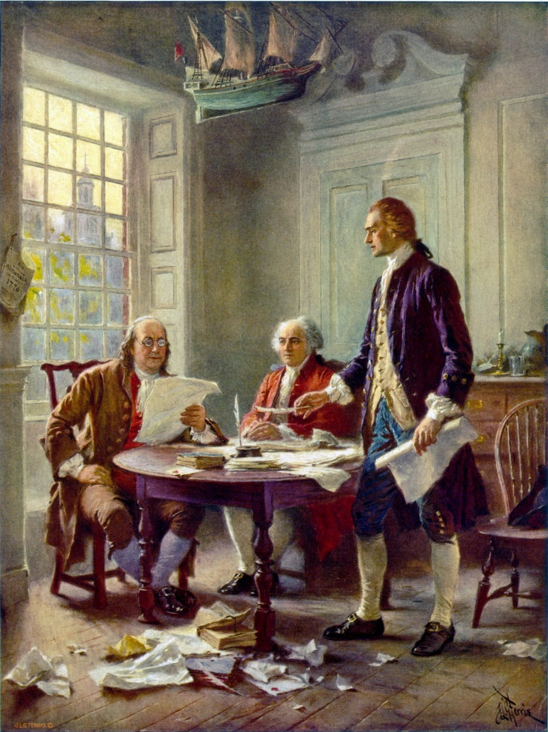
Declaring Independence
Congress appointed a committee to draw up a statement giving the reasons for separation from Great Britain
Thomas Jefferson was the chief author of the Declaration of Independence
John Adams and Benjamin Franklin were also on the committee. They had only minor edits to Jefferson’s masterpiece.

Slide 10
Declaring Independence
Jefferson Writes the Declaration of Independence (3:43)
Jefferson meets with Adams and Franklin (4:01)

Slide 11
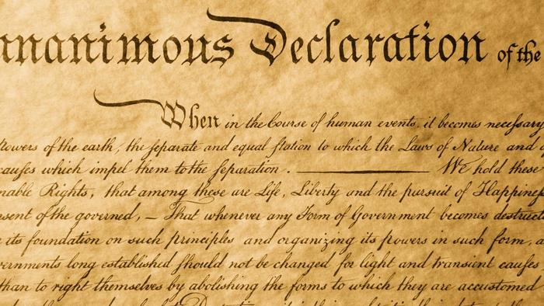
Declaring Independence
The Declaration of Independence formally announced the colonies’ break from Great Britain.

Slide 12
Declaring Independence
The Declaration of Independence formally announced the colonies’ break from Great Britain.
After the Preamble (introduction) the Declaration has 3 main parts
Part One: Natural Rights
Reflecting ideas of the Enlightenment, Jefferson states some central principles held by the new government
“All men are created equal”
“Endowed by their creator with certain unalienable rights”
Governments are created to protect people’s rights
If a government violates those rights, the people have a right to abolish their government and create another.

Slide 13
Declaring Independence
The Declaration of Independence formally announced the colonies’ break from Great Britain.
Part One: Natural Rights
Part Two: List of Grievances (formal complaints) against the king; ways the king had violated the colonists’ rights
“imposing taxes upon us without our consent”
“depriving us, in many cases, of trial by jury”
“has kept among us, in times of peace, standing armies…”
“quartering large bodies of armed troops among us”
“cutting off out trade with all parts of the world”
Jefferson concluded this section by stating that King George III was “unfit to be the ruler of a free people.”

Slide 14
Declaring Independence
The Declaration of Independence formally announced the colonies’ break from Great Britain.
Part One: Natural Rights
Part Two: List of Grievances
Part Three: Dissolving the Bonds
People have the right to abolish unjust governments… the king has violated colonists’ rights… therefore the colonies declare themselves to be “free and independent states”
All political connection between the colonies and Great Britain “is and ought to be totally dissolved”

Slide 15
Declaring Independence
July 4, 1776
The Second Continental Congress approved the Declaration of Independence.
The United States of America was born.
(The actual signing of the Declaration took place on August 2, 1776)

Slide 16
Declaring Independence
Impact of the Declaration of Independence
The signers of the Declaration were committing treason against Great Britain. If caught, they faced death.
“We must all hang together, or most assuredly we shall all hang separately.”
- Benjamin Franklin

Slide 17
Declaring Independence
Impact of the Declaration of Independence
The signers of the Declaration were committing treason against Great Britain. If caught, they faced death.
The Declaration changed the nature of the war. Now Patriots were not fighting for fair treatment from Great Britain, but fighting to create a new nation.
America the Story of US: The Declaration of Independence (4:00)

Slide 18
Declaring Independence
Impact of the Declaration of Independence
The signers of the Declaration were committing treason against Great Britain. If caught, they faced death.
The Declaration changed the nature of the war. Now Patriots were not fighting for fair treatment from Great Britain, but fighting to create a new nation.
50,000+ Loyalists, facing persecution, leave the colonies.
Most go to Canada where Britain allowed them self-rule
Families are separated – including Benjamin Franklin from his loyalist son William Franklin
Loyalists abandon homes and property

Slide 19
Declaring Independence
Impact of the Declaration of Independence
The signers of the Declaration were committing treason against Great Britain. If caught, they faced death.
The Declaration changed the nature of the war.
50,000+ Loyalists, facing persecution, leave the colonies.
The Declaration of Independence has become one of the world’s enduring documents – inspiring Americans and people around the world.

Slide 20
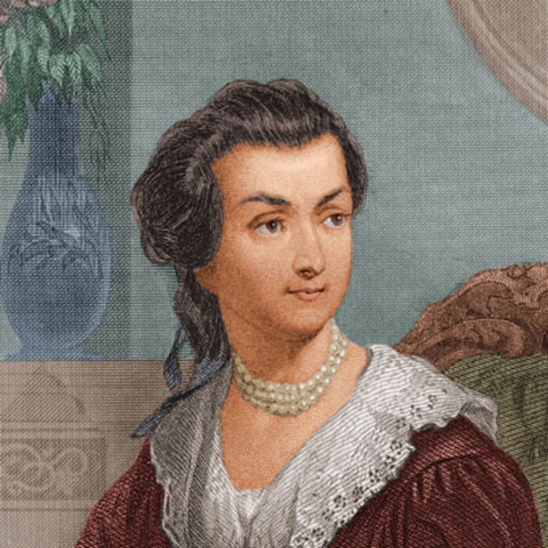
Declaring Independence
All men are created equal?
There is unfinished business.
Women
Women’s rights not included in the
Declaration
“Remember the Ladies, and be more generous and favorable to them than your ancestors. Do not put such unlimited power in the hands of the Husbands… If particular care and attention is not paid to the Ladies we are and will not hold ourselves bound by Laws in which we have no voice, or Representation.”
Abigail Adams, in a letter to her husband John Adams,
quoted in Notable American Women

Slide 21
Declaring Independence
All men are created equal?
There is unfinished business
Women
African Americans
Jefferson compared life under Great Britain’s rule to life in slavery
How could slavery exist in a land that so valued freedom?
In 1776, slavery was legal in all 13 colonies
When discussing slavery in the Congress, the southern colonies threatened to walk out if slavery was abolished.
America will pay dearly for the continuance of this “original sin”

Slide 22
Declaring Independence
All men are created equal? Unfinished business
Women
African Americans
Native Americans
Despite the Proclamation of 1763, American colonists continued to move into lands that belonged to Native Americans.
The declaration of Independence did not address the rights of the lives, liberty, or property of Native Americans.

Slide 23
Declaring Independence
“And for the support of this Declaration, with a firm reliance on the protection of divine Providence, we mutually pledge to each other our Lives, our Fortunes, and our sacred Honor. “
Thomas Jefferson, The Declaration of Independence
Americans had declared independence. Now they had to win the war.

Slide 24
End of Part Three.

