Slide 1
The Great Depression
Part One: The End of Prosperity

Slide 2
Warning Signs of an Economy in Trouble
Stock market crash
Great
Depression
Overproduction
Business failures
Banking crisis
Unemployment

Slide 3
Warning Signs of an Economy in Trouble
Overproduction
Overproduction led to low prices for agricultural and manufactured goods; Income for farmers and workers fell throughout the 1920s.
Two key industries – housing and automobiles – were hit especially hard.
Many people, however, had cut back on spending.
Overproduction resulted in a huge supply of goods.

Slide 4
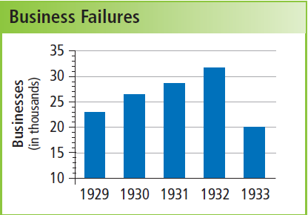
Warning Signs of an Economy in Trouble
Overproduction
Business Failures
With little money, consumers stopped spending. Business profits plunged.
Many companies closed, forced into bankruptcy.

Slide 5
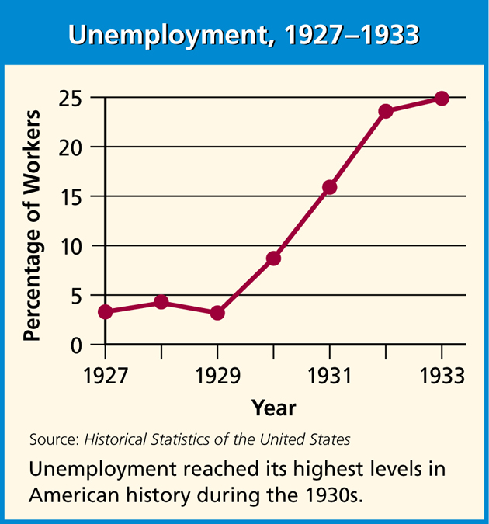
Warning Signs of an Economy in Trouble
Overproduction
Business failures
Unemployment
By 1933, some 13
million people were
unemployed.
Some resorted to
selling apples and
pencils on the street.
Even those with jobs
suffered from pay
cuts.

Slide 6
Warning Signs of an Economy in Trouble
Overproduction
Business failures
Unemployment
Banking crisis
Many people were unable to repay their loans.
Banks also lost money on the stock market.
When they ran out of money, the banks went out of business.

Slide 7
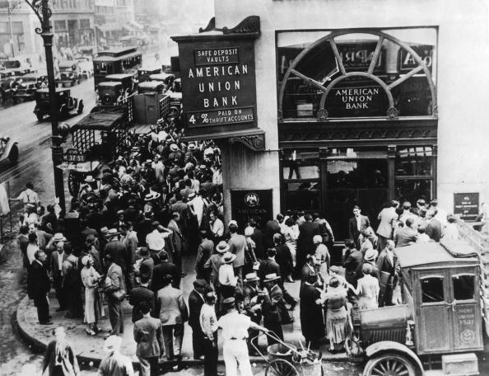
Terrified depositors ran to their banks, demanding
their money.
Many found that their money was gone.

Slide 8
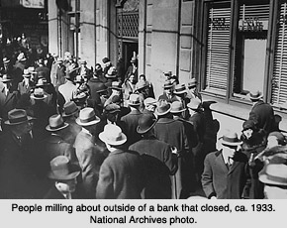

Slide 9
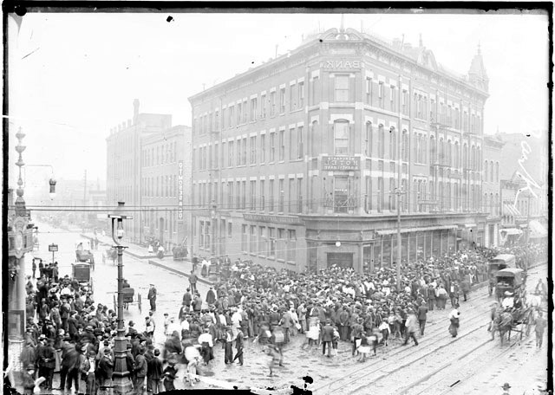
Crowd gathered on the sidewalks and the street by the Milwaukee Avenue Bank during a bank failure.
Exterior view of a crowd gathered on the sidewalks and the street. The bank was located at 739-47 Milwaukee Avenue (formerly 409-415 Milwaukee Avenue) in the West Town community area of Chicago. Courtesy of the Chicago Historical Society.

Slide 10
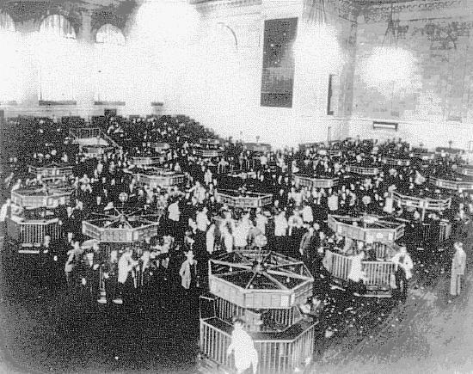
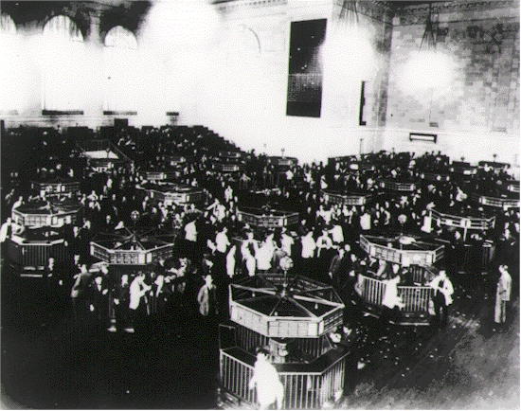
The trading floor of the New York Stock Exchange just after the crash of 1929. On Black Tuesday, October twenty-ninth, the market collapsed. In a single day, sixteen million shares were traded--a record--and thirty billion dollars vanished into thin air. Westinghouse lost two thirds of its September value. DuPont dropped seventy points. The "Era of Get Rich Quick" was over. Jack Dempsey, America's first millionaire athlete, lost $3 million. Cynical New York hotel clerks asked incoming guests, "You want a room for sleeping or jumping?"

Slide 11
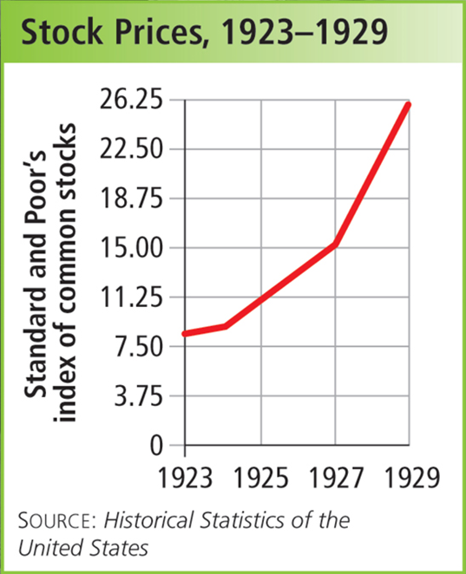
Warning Signs of an Economy in Trouble
Overproduction
Business failures
Unemployment
Banking crisis
Stock market crash
Despite these warning
signs, stock prices
continued to skyrocket..
President Herbert Hoover
maintained an optimistic
outlook.

Slide 12
Many Americans had bought stocks on margin, gambling that prices would continue to soar. Few considered what would happen if the bull market turned into a bear market.
Brokers who had lent people money to buy stocks on margin called in the loans.
Many were likely to default, so they sold their stocks.
Stock prices dropped even more.
They lost their gamble in October 1929, when stock prices began a rapid slide.

Slide 13
The Stock Market Crash
August – October, 1929
Nervous investors start to leave the market
Brokers call for payment on margin loans
October 29, 1929
“Black Tuesday”
Prices plummet; no buyers for stocks
Valuable stock now worthless paper

Slide 14
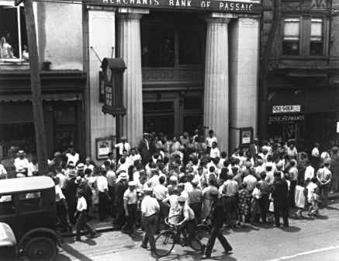
By 1933 the banking system in the United States was near collapse. Some banks had made speculative investments in the stock market and were hurt by the crash of 1929. Others failed when depositors, fearing that their bank would go bankrupt, rushed to withdraw their savings. Here, depositors besiege Merchants Bank in Passaic, New Jersey.

Slide 15
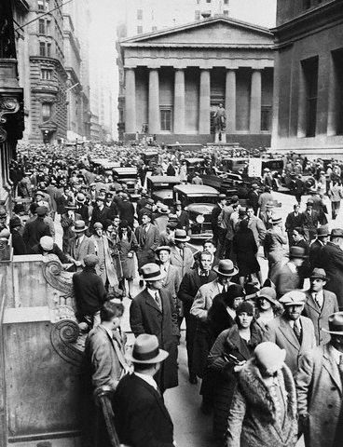
Panic on Wall Street People crowd Wall Street after the Stock Market Crash of 1929. Commissioner Whalen dispatched an extra detail of 400 police officers to guard the area.

Slide 16
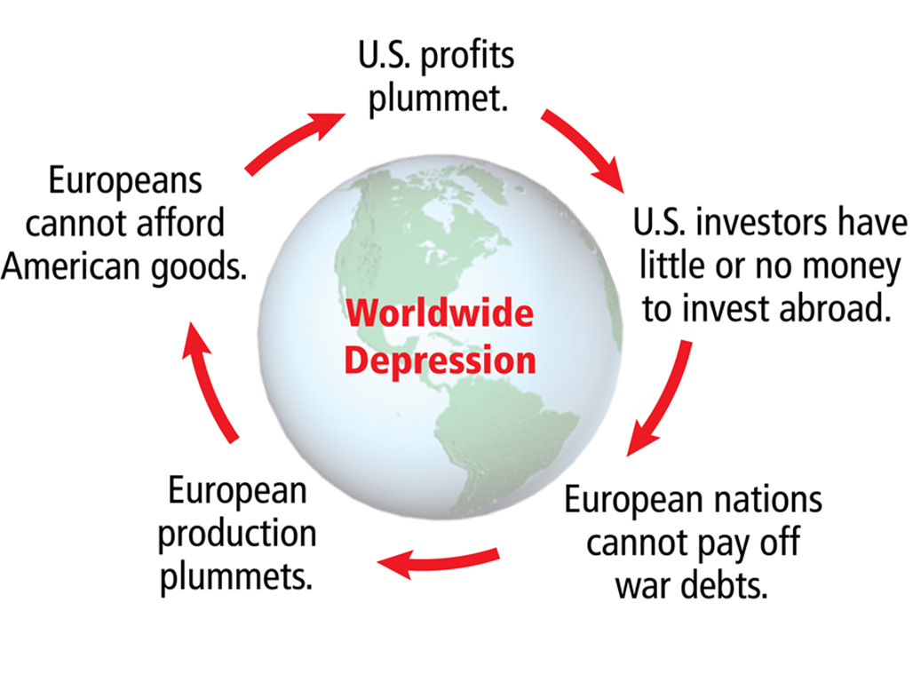

Slide 17
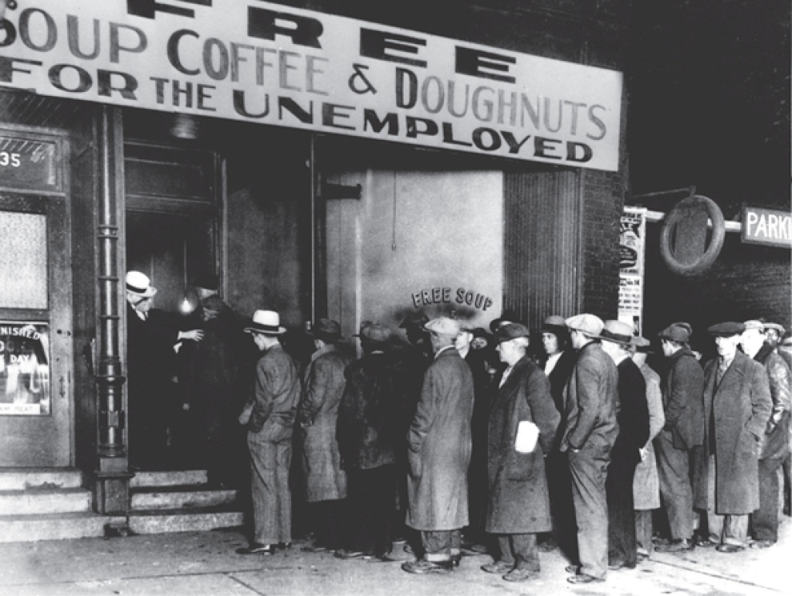
As the Depression worsened, poverty swept across the country.
In earlier times, people could rely on their own farms to get by.
Now, urban Americans struggled to feed their families.
People lined up for food at soup kitchens run by churches and other charities.

Slide 18
Hoover Takes Action
Did not think the gov’t should get directly involved in helping business
Felt business should correct their own problems and end the downslide
Believed it was up to private individuals and institutions to provide aid
Opposed relief programs at first
Relief: giving help to the needy
Urged business to keep workers employed
Called on private charities to help

Slide 19
Private Charities Do What they Can
Churches, YMCA, other charities open soup kitchens
Ethnic community leaders organize their own relief programs

Slide 20
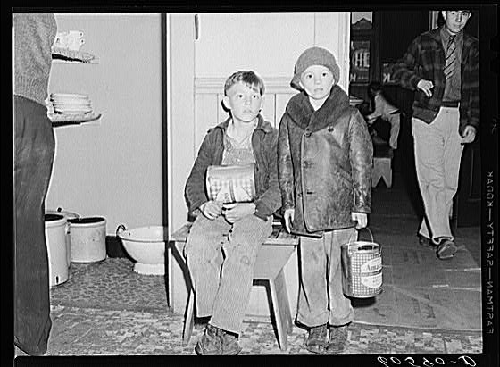
Young boys waiting in kitchen of city mission for soup which is given out nightly. Dubuque, Iowa. Photographer: John Vachon. For millions, soup kitchens offered the only food they would eat.

Slide 21
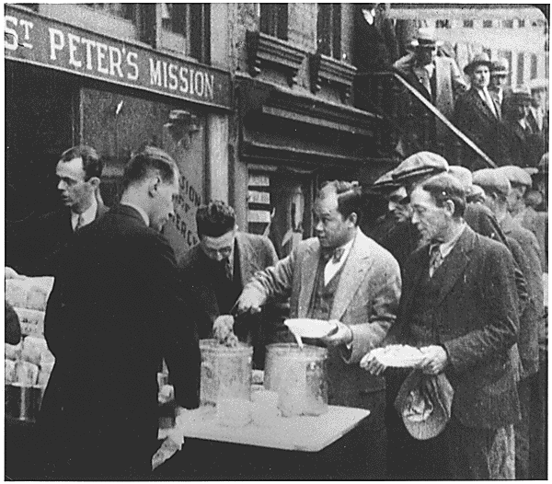

Slide 22
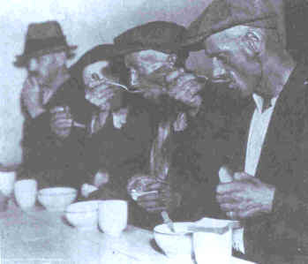

Slide 23
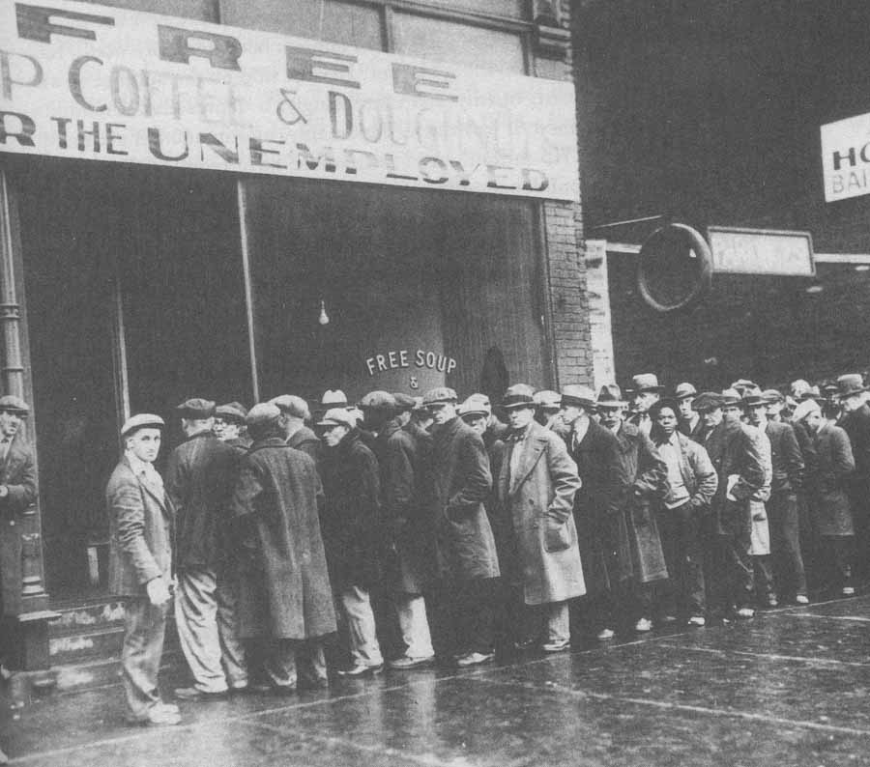

Slide 24
Government Programs
The need overwhelmed private charities. Hoover realizes the gov’t must step in.
Reconstruction Finance Corporation: (RFC) loaned money financial institutions such as banks and farm mortgage companies in order to keep them in business
Gave money to local governments for public works programs: the gov’t hires workers to construct public buildings, dams and highways.
Although he did more than any other president had done, it was too little too late.

Slide 25
“Hoovervilles”

Slide 26
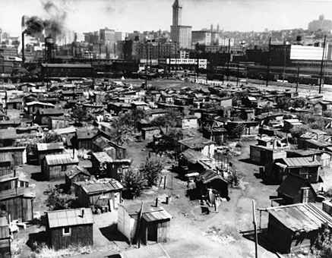

Slide 27
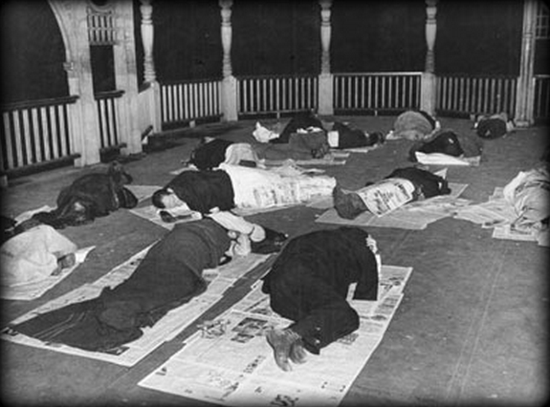
“Hoover Blankets”
(Which picture is from the Great Depression?)

Slide 28
Hoover was blamed for everything!
(Was that fair?)
Hoovervilles = shantytowns
Hoover blankets = newspapers
Hoover flags = pockets pulled inside out
(no money!)
Hoover tourists = young people traveling the country by rail
Hoover leather = cardboard used to line shoes with holes in the soles
Hoover wagon = cars pulled by horses
Hoover hogs = wild rabbits that country people caught for food

Slide 29
Hoover’s Reaction
The Bonus Army
WWI veterans had been promised a bonus (sum of money) in 1945.
20,000 jobless vets march on Washington in 1932.
Some brought their wives and children
Camped along the Potomac for two months.
The Senate rejected a bill to pay them the bonus early. Most of the veterans head home, but 2000 remain.

Slide 30
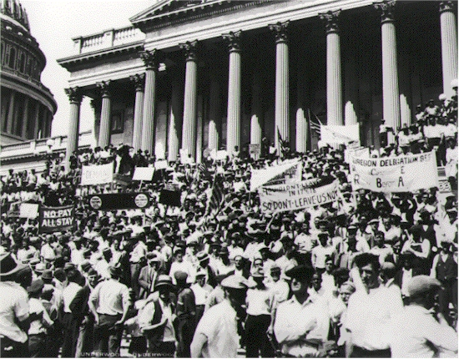
World War I veterans block the steps of the Capital during the Bonus March, July 5, 1932 (Underwood and Underwood). In the summer of 1932, in the midst of the Great Depression, World War I veterans seeking early payment of a bonus scheduled for 1945 assembled in Washington to pressure Congress and the White House. Hoover resisted the demand for an early bonus. Veterans benefits took up 25% of the 1932 federal budget. Even so, as the Bonus Expeditionary Force swelled to 60,000 men, the president secretly ordered that its members be given tents, cots, army rations and medical care.

Slide 31
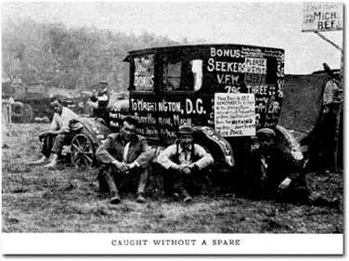

Slide 32
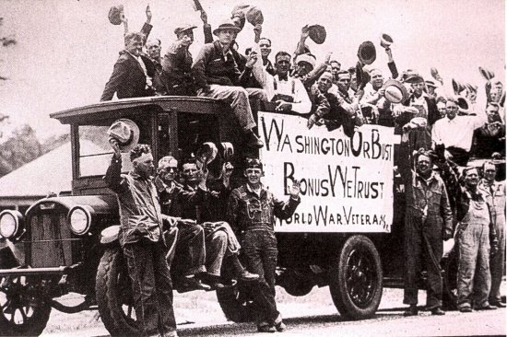
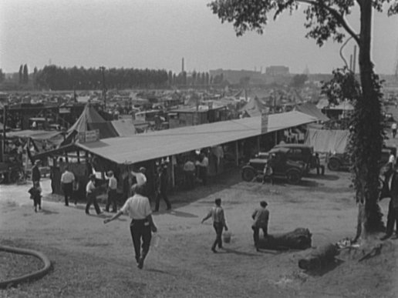

Slide 33
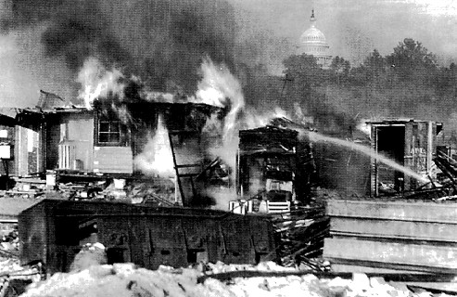
Shacks, put up by the Bonus Army on the Anacostia flats, Washington, D.C., burning after the battle with the military. The Capitol in the background. 1932.

Slide 34
Hoover’s Reaction
Bonus Army
Local police try to force the veterans to leave – Four veterans die in the conflict
Hoover orders General Douglas MacArthur to clear out the veterans
MacArthur uses machine guns, tear gas, and tanks
Burns the camp to the ground
The President loses what little support he has. An election is coming.

Slide 35
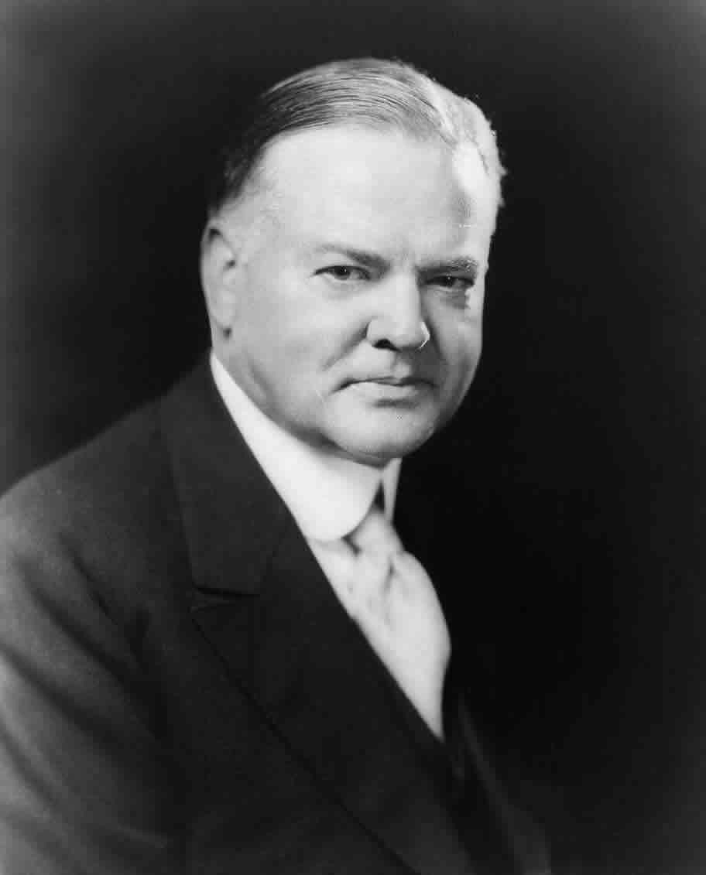
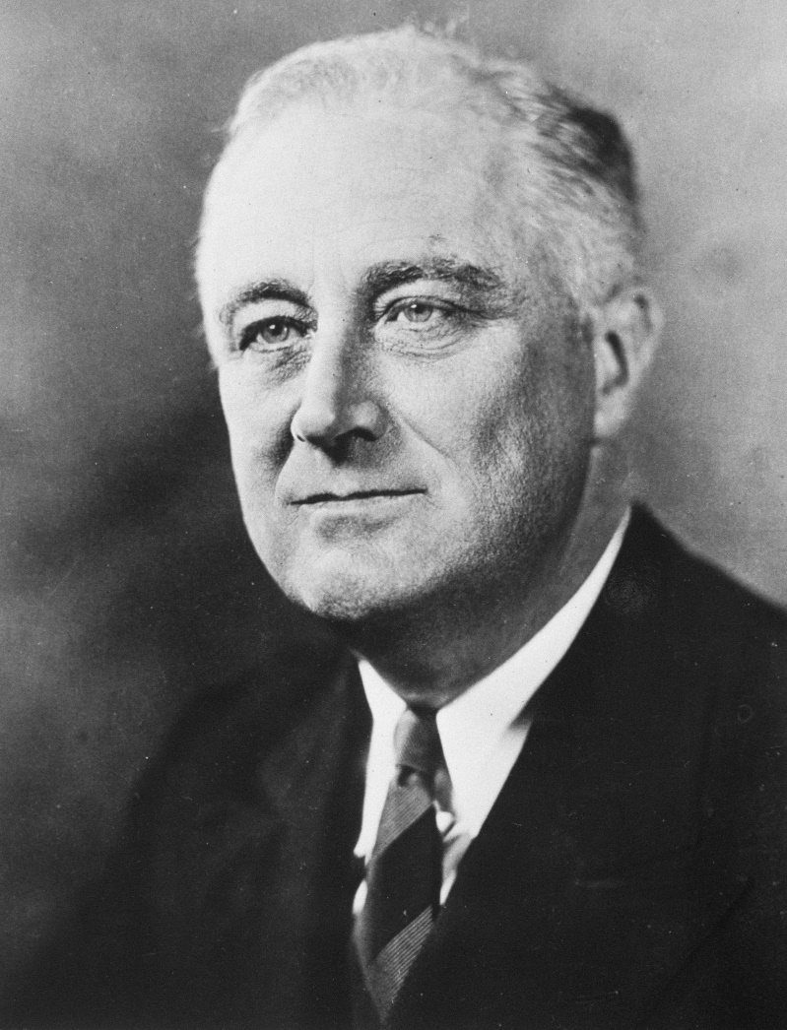
The Election of 1932
Herbert Hoover (R)
Franklin Delano Roosevelt (D)

Slide 36
The Election of 1932
Hoover called the election “a contest between two
philosophies of government.”
He believed that government aid programs would
weaken Americans’ spirit of individualism and
self-reliance.
Americans had lost confidence in President Hoover,
however, and elected Franklin Roosevelt, the former
governor of New York.

Slide 37
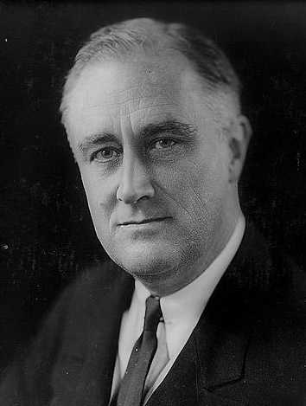
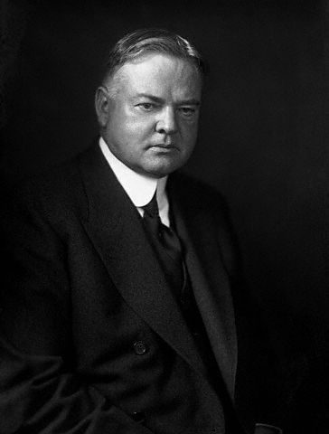
November 1932 – Roosevelt defeats Hoover in a landslide victory

Slide 38
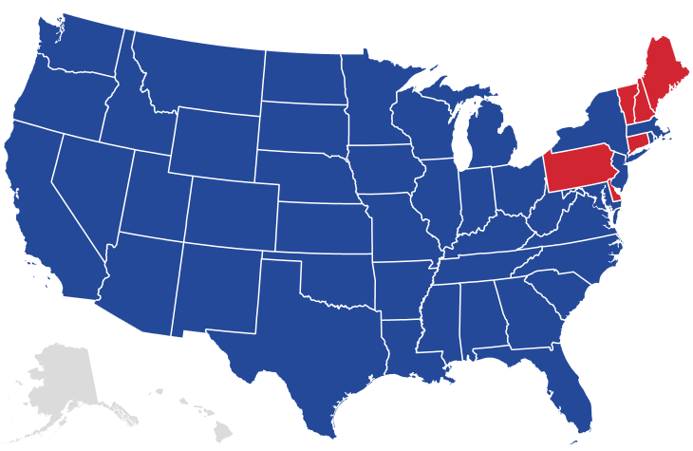
The Election of 1932
Herbert C. Hoover (R) (I)
Electoral 59
Popular 15,761,841
Franklin D. Roosevelt (D)
Electoral 472
Popular 22,821,857

Slide 39
Franklin Delano Roosevelt

Slide 40
Biography
Born in Hyde Park, NY in 1882
Private tutors at home until age 14
Attended Groton
BA in History from Harvard (3 years)
Studied law at Columbia
Passed the bar exam, left law school

Slide 41
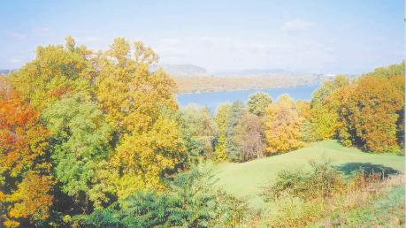
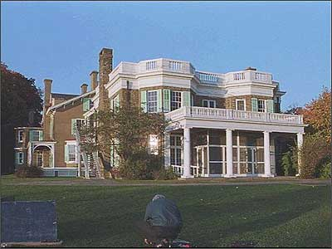

Slide 42
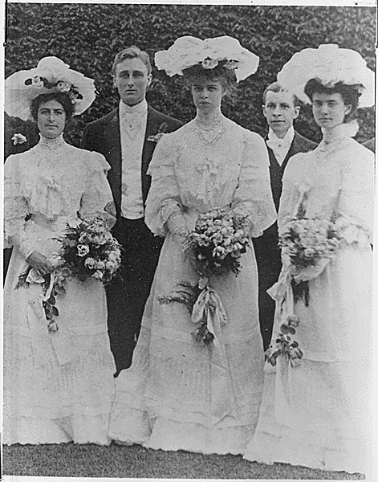
Married Anna Eleanor Roosevelt,
niece of Pres. Theodore Roosevelt

Slide 43
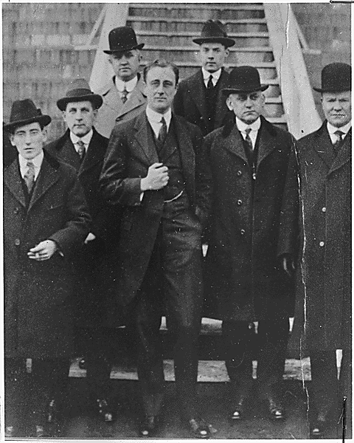
Served as Assistant
Secretary of the Navy
during World War One
(just like “Uncle Teddy”)

Slide 44
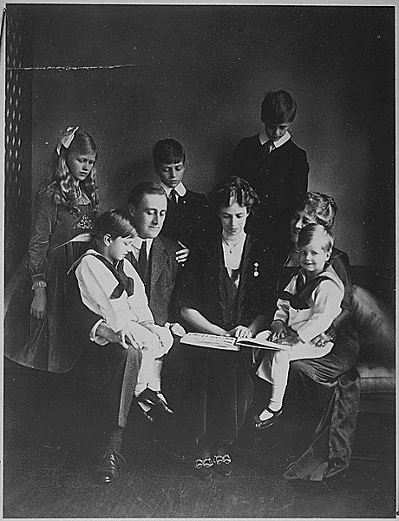
Father of five children

Slide 45
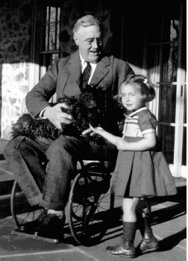
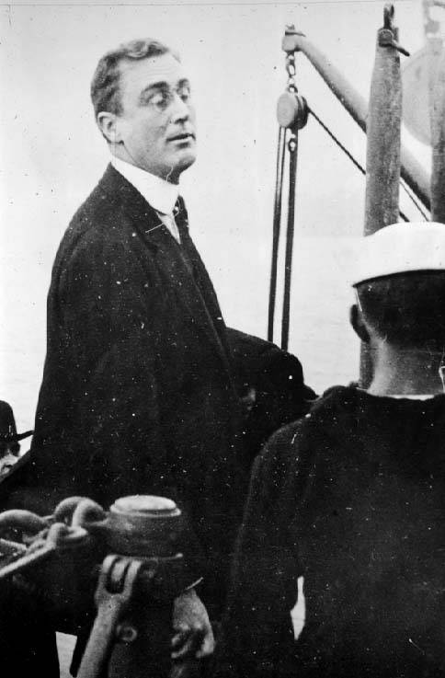
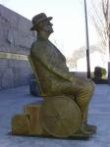
FDR contracted polio in 1921.
His legs were paralyzed.
He was a paraplegic.

Slide 46
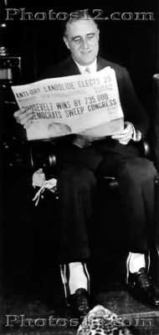
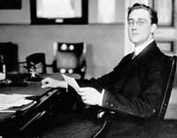
He was elected governor of New York State in 1928.
As governor, FDR…
- provided relief for the state’s citizens – especially
farmers
- established the Temporary Relief Administration
which gave aid to unemployed New Yorkers

Slide 47
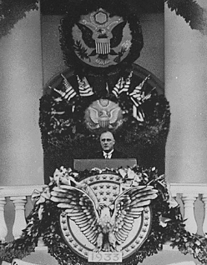
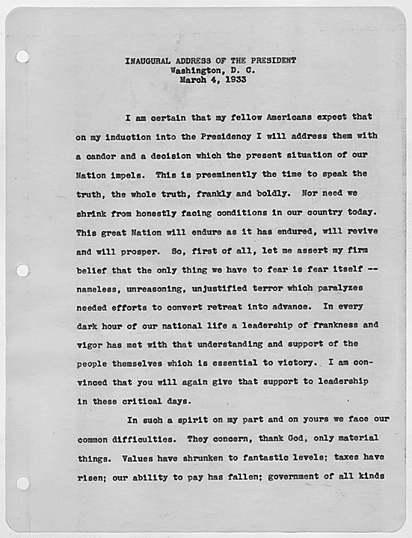
http://FDR's First Inaugural Newsreel (9 min)

