Slide 1
The American Revolution
Part One
Conflict in the Colonies

Slide 2
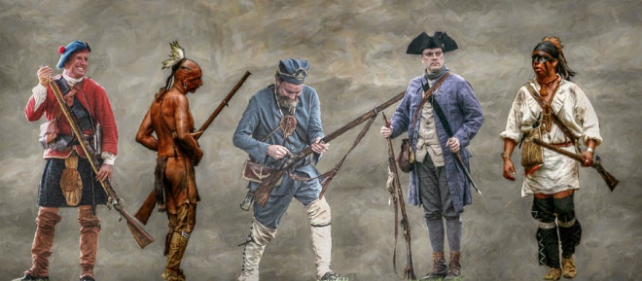
Conflict in the Colonies
The Colonies and Britain Grow Apart
The colonies fought side by side with the British during the French and Indian War.

Slide 3
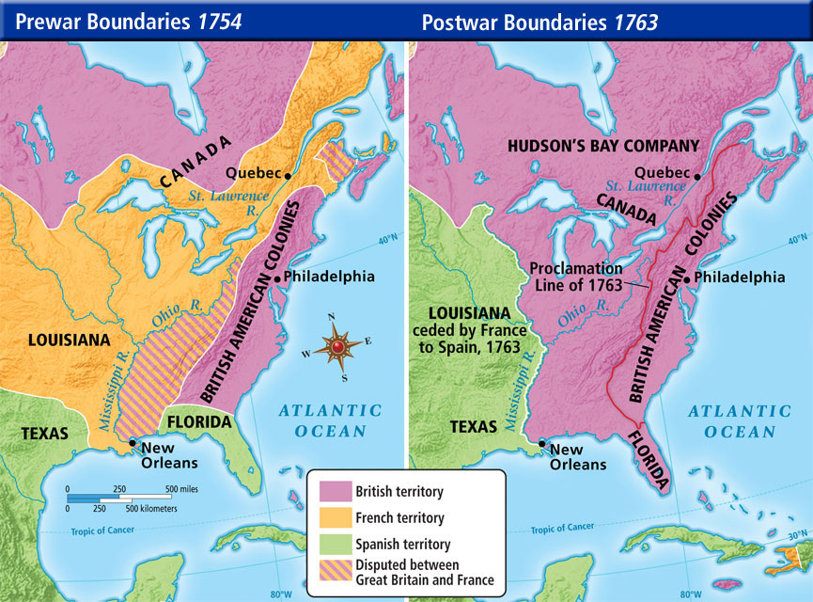
Conflict in the Colonies
Colonists looked forward to settling into the fertile lands of the Ohio River Valley

Slide 4
Conflict in the Colonies
The British took over French forts.
British settlers moved onto Native American land.
They cleared land for farming, built roads, and villages.
They refused to trade with Native Americans the way the French had.

Slide 5
Conflict in the Colonies
Native Americans respond
Native American leaders like Chief Pontiac responded by attacking settlers and destroying many British forts west of the Appalachians. This event was called Pontiac’s Rebellion.

Slide 6
Conflict in the Colonies
British settlers fought back.
They killed Indians – even those who had not attacked them.
British officers came up with a plan.
They invited Indian leaders into their camp to talk
They gave them blankets infected with small pox as gifts
A deadly outbreak spread throughout the Native Americans

Slide 7
Conflict in the Colonies
“Could it not be contrived to send the Small Pox among those disaffected (angry) tribes of Indians? We must on this occasion use every stratagem in our power to reduce them.”
Major General Jeffrey Amherst
quoted in The Conspiracy of Pontiac

Slide 8
Conflict in the Colonies
British leaders are concerned there will be more fighting on the frontier if colonists continue to settle there.
Defending the western lands will be costly. King George decides to keep 10,000 soldiers in the colonies to keep peace in the western lands.
The British issued the Proclamation of 1763.
Colonists are forbidden to settle west of the Appalachian Mountains. Settlers already there were told to leave.
Colonists are angry.
They had fought along with their fellow British to win those lands.
They felt they had a right to settle there.

Slide 9
Conflict in the Colonies
Great Britain needed to pay debts incurred in the French and Indian War.
They also needed to pay for a standing army to protect the colonists from Native American attacks.
Great Britain needs revenue (income) to meet these expenses.
Great Britain wants the colonies to contribute to the costs of frontier defense.
British Prime Minister George Grenville asks Parliament to tax the colonies.

Slide 10
Conflict in the Colonies
1764
Parliament passes the Sugar Act.
- Placed duties on sugar and molasses sent to the colonies.
- Duty: A customs duty is a tariff or tax imposed on goods
coming into a country
- Also called for strict enforcement of the act and harsh
punishment of smugglers.
- Primarily impacted colonial merchants.
Parliament gives greater authority to the British Vice-Admiralty Courts.
- No juries
- Suspected smugglers treated as guilty until proven innocent,
contrary to British law which presumed accused persons
innocent until proven guilty.

Slide 11
Conflict in the Colonies
1764
The colonists respond to the Stamp Act.
- Massachusetts lawyer James Otis:
“Taxation without representation is tyranny!”
George Grenville stated that the colonists were subjects of Britain, not citizens. Since they enjoyed the protection of Great Britain, they were subject to taxation by Great Britain.

Slide 12
Conflict in the Colonies
1764
The colonists respond to the Sugar Act.
Samuel Adams
founded the Committees of Correspondence: groups that shared information and ideas about the British laws and ways to challenge them throughout the colonies

Slide 13
Conflict in the Colonies
1764
Parliament passed the Quartering Act.
required the colonists to quarter, or house, British soldiers and provide them with supplies.
British General Thomas Gage, commander of the British forces, put most of the troops in New York City.

Slide 14
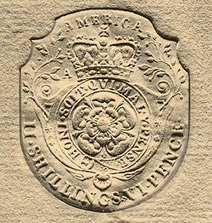
Conflict in the Colonies
1765
Parliament passed the Stamp Act.
- required all legal and commercial documents to carry an
official stamp showing that a tax had been paid.
- included licenses, newspapers,
pamphlets, even playing cards
- Unlike the Sugar Act which
primarily impacted merchants,
this directly taxed the colonists.

Slide 15
Conflict in the Colonies
1765
The colonists respond to the Stamp Act.
The colonists began to boycott British goods holing to hurt the British economy and convince Parliament to end the tax.
- Boycott: a refusal to buy (British goods)

Slide 16
Conflict in the Colonies
1765
The colonists respond to the Stamp Act.
- Boycotts
- Some colonists formed secret societies like the
Sons of Liberty.
- Organized by Samuel Adams with others
- Organized protests against the Stamp Act
- Sometimes used violence, especially against
British customs officials.

Slide 17
Conflict in the Colonies
1765
The colonists respond to the Stamp Act.
- Boycotts
- Sons of Liberty
- Patrick Henry, member of the Virginia House of
Burgesses spoke in sympathy of resistance to
Great Britain.
- When another member shouted that resistance to
Britain was treason, Henry replied,
“If this be treason, make the most of it!”
Many colonists were convinced by Patrick Henry.

Slide 18
Conflict in the Colonies
1765
The colonists respond to the Stamp Act.
- Boycotts
- Sons of Liberty
- Patrick Henry
- Stamp Act Congress: Delegates from nine colonies
gathered in New York City.
- Issued a statement that the Stamp Act
violated their rights
- Called on Britain to repeal the Stamp Act.
- The colonies are beginning to work together.

Slide 19
Conflict in the Colonies
1766
Great Britain repeals the Stamp Act.
Repeal: to cancel, take back
London merchants complain to Parliament that their business will be hurt by the boycotts.
Some parliamentary leaders, including William Pitt, agree with American thinking about taxing the colonies.

Slide 20
Conflict in the Colonies
1766
“The Americans have not acted in all things with prudence and (good) temper. They have been driven to madness by injustice. Will you punish them for the madness you have (caused)? …My opinion …is that the Stamp Act be repealed absolutely, totally, and immediately.”
William Pitt, quoted in Patriots by A.J. Langguth

Slide 21
Conflict in the Colonies
1766
Parliament repeals the Stamp Act, but passes the Declaratory Act.
stated that Parliament has “supreme authority” to govern the colonies “in all cases whatsoever.”
Colonists celebrate the repeal of the Stamp Act and try to ignore the Declaratory Act.

Slide 22
Conflict in the Colonies
1767
Great Britain still needed to raise money.
The Quartering Act was not working. Most soldiers were in NYC, and New Yorkers felt it was an unfair burden. NY’s assembly refused to pay for the British troops.
The king’s finance minister Charles Townshend, goes to Parliament with a plan to raise revenue.

Slide 23
Conflict in the Colonies
1767
Parliament passed the Townshend Acts.
Suspended NY’s assembly until it agreed to provide housing for troops.
Placed duties (import taxes) on goods such as glass, lead, paper, paint, and tea.
To enforce the Acts, British officials would use writs of assistance, search warrants that would allow them to enter homes or businesses to search for smuggled goods.

Slide 24
Conflict in the Colonies
1767
The colonists respond to the Townshend Acts.
“The issue is whether Parliament can legally take money our of our pockets without our consent.”
- John Dickinson, Pennsylvania farmer

Slide 25
Conflict in the Colonies
1767
The colonists respond to the Townshend Acts.
“Let these truths be… impressed upon our minds – that we cannot be happy without being free – that we cannot be free without being secure in our property – that we cannot be secure in our property if without our consent others may... take it away - that taxes imposed on us by Parliament do thus take it away – that duties laid for the sole purpose of raising money are taxes – that attempts to lay such duties should be instantly and firmly opposed.
- John Dickinson

Slide 26
Conflict in the Colonies
1767
The colonists respond to the Townshend Acts.
Colonists feel that the writs of assistance violate their natural rights as described by John Locke during the Enlightenment.
“The law of nature, teaches that “no one ought to harm another in his life, health, liberty, or possessions.”

Slide 27
Conflict in the Colonies
1767
The colonists respond to the Townshend Acts.
Samuel Adams led another boycott of British goods.
He wrote a letter stating that the Acts violated colonists’ rights. The Mass. Assembly sent it to the other colonies.
Other colonies joined the protests.
The Daughters of Liberty called on colonial women to weave their own cloth, called homespun, make their own clothes, and use American-made products.
Colonial leaders called for peaceful protests, but tempers ran high.

Slide 28
Conflict in the Colonies
1767
Customs officers in Boston seize the ship Liberty which was carrying smuggled wine.
The ship’s owner and the Sons of Liberty were angered. They attacked customs official’s homes. A riot broke out.
The (British) governor of Massachusetts broke up the Massachusetts legislature and called for more British troops.
Sam Adams said….

Slide 29
Conflict in the Colonies
“We will destroy every soldier that dares put his foot on shore… I look upon them as foreign enemies.”

Slide 30
Conflict in the Colonies
1768
General Thomas Gage arrives in Boston with 1000 British troops.
Colonists resent the “redcoats.” The soldiers were poorly paid and often hired themselves out as laborers at lower rates than American workers.
Colonists and soldiers called each other names (“Lobsterback! Yankee!) and scuffled in the streets.

Slide 31
Conflict in the Colonies
1770
The Boston Massacre
- March 5, 1770
Colonial dockworkers and youths start taunting British soldiers standing guard.
- A soldier pushes a youth aside.
The crowd – including Crispus Attucks – protests, hurls snowballs, rocks
A fight erupts. Attucks and four other colonials were killed.

Slide 32
Conflict in the Colonies
1770
The Boston Massacre
Sam Adams and the Sons of Liberty use the event as propaganda – a story designed to persuade, giving only selected facts or one side of the story.
They called the event the “Boston Massacre.”
Paul Revere created a detailed print called “The Bloody Massacre Perpetrated on King Street.
The incident was used as anti-British propaganda in newspapers, pamphlets, and posters.

Slide 34
Conflict in the Colonies
John Adams and the Boston Massacre (Video 9:06)

Slide 35
Conflict in the Colonies
1770
The Boston Massacre
The soldiers were arrested for murder.
John Adams – Sam Adams’s cousin - and Josiah Quincy, Boston lawyers, defended the soldiers.
Adams was criticized for taking the case, but he said the law must be “deaf… to the clamors of the populace.”
He supported the colonial cause, but wanted to show the colonists followed the rule of law.
The lawyers argued that the soldiers had fired in self defense.
Two soldiers were found guilty of killing the colonists accidentally. They were branded on the hand and released.
Ironically, the same day as the Boston Massacre, Parliament proposed repealing most provisions of the Townsend Acts.

Slide 36
Conflict in the Colonies
1773
The Tea Act is passed by Parliament.
Most colonists were drinking tea smuggled from Holland.
The Tea Act gave the British East India Company control over the tea trade to America. Colonists would now have to pay a tax on regulated tea.

Slide 37
Conflict in the Colonies
1773
Colonists respond to the Tea Act.
Colonists in SC unload tea and let it rot on the dock.
In New York City and Philadelphia colonists would not let tea ships land.
In Boston, the Sons of Liberty organized the Boston Tea Party.
Disguised as Indians, they sneaked onto three tea-filled ships and dumped 340 barrels of tea into Boston Harbor.

Slide 39
Conflict in the Colonies
1774
Parliament passed the Coercive Acts, a series of laws designed to punish Massachusetts and serve as a warning to the other
colonies. In the colonies these laws became known as the Intolerable Acts because they were viewed as very restrictive and harsh.

Slide 40
Conflict in the Colonies
1774
The Intolerable Acts
Closed the Port of Boston until colonists paid for the destroyed tea
Britain allowed to quarter troops wherever they wanted – including people’s homes
Massachusetts’s charter was cancelled and their legislature was disbanded.
British officials accused of crimes were sent to Britain for trial where they would face a more sympathetic judge and jury.
A large land grant made to expand the Quebec colony.
Thomas Gage appointed the new governor of Massachusetts to enforce order.

Slide 43
End of Part One.

