Slide 1
The American Revolution
Part Two
The Revolution Begins

Slide 2
The Revolution Begins
Underlined words and phrases indicate vocabulary terms
Red print indicates names to know.
Green print indicates key battles to know.

Slide 3
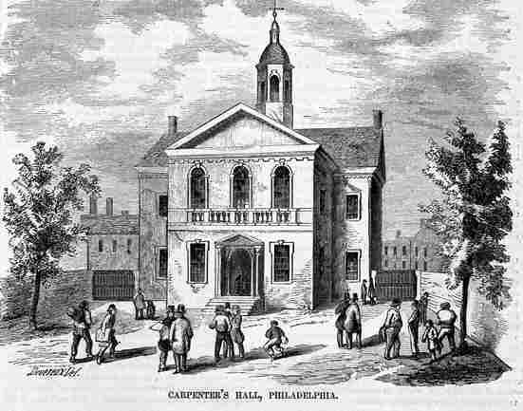
The Revolution Begins
The First Continental Congress
What: a gathering of colonial leaders who were deeply troubled about the relationship between Great Britain and its American colonies
When: 1774 – after the closing of Boston Harbor
Who: Delegates from 12 of 13 colonies attended (GA did not attend.)
Where: Met at Carpenters’ Hall in Philadelphia

Slide 4
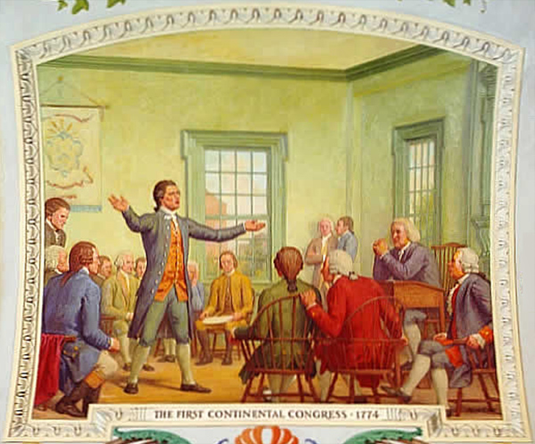
The Revolution Begins
Goal of the First Continental Congress:
communicate the colonists’ concerns to the king
ask the king to correct the problems
The colonists did NOT seek separation from Great Britain, but the colonies are working together to demand colonial rights.
This plants the seeds of a future independent government.

Slide 5
The Revolution Begins
Some delegates believed violence with Great Britain was unavoidable. Others had strict orders to seek peace.
Actions taken by the First Continental Congress:
Demanded Great Britain repeal the Intolerable Acts.
Encouraged colonists to continue their boycott of British goods.
Drafted the Declaration of Rights – a list of ten resolutions to present to the King, including the right to “life, liberty, and property.”
Told colonial militias – organized body of armed volunteers - to prepare for war.

Slide 6
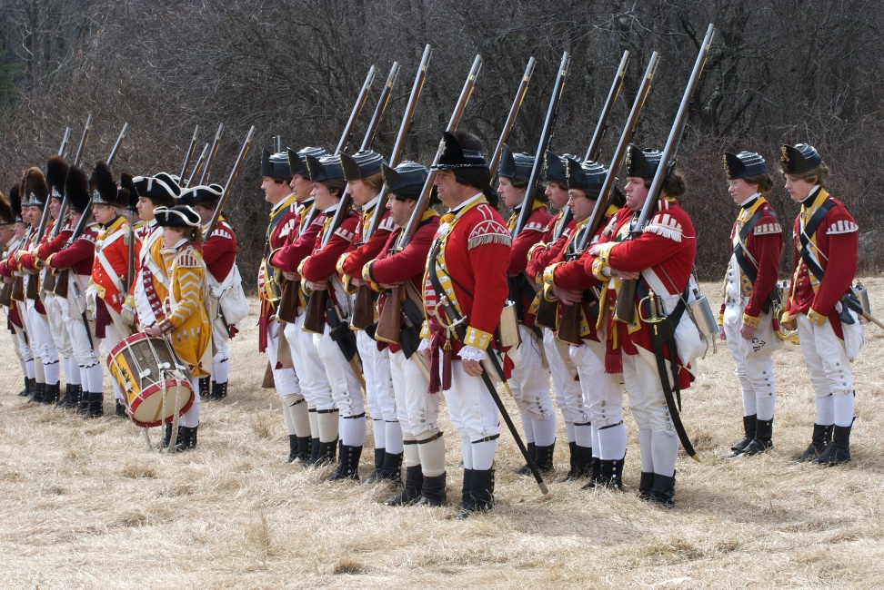
The Revolution Begins
Colonists hope that their trade boycott and protests will force a repeal of the Intolerable Acts. After all, the Stamp Act and Townshend Acts had been repealed.
This time, however, Parliament stood firm. They did not repeal the acts. In fact, they sent more troops and increased restrictions on colonial trade.

Slide 7
The Revolution Begins
Colonial troops continue to train.
Most felt a fight with Britain would be short.
They thought a show of force by the colonists would make Britain change its policies.
Few expect a war. One who did was Patrick Henry. Speaking to the VA House of Burgesses he said -

Slide 8
The Revolution Begins
“They tell us, sir, that we are weak; unable to cope with so formidable an adversary. But when will we be stronger? Gentlemen may cry, Peace, Peace – but there is no peace. I know not what course others may take; but as for me, give me liberty or give me death!”
- Patrick Henry

Slide 9
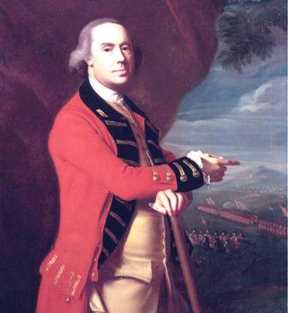
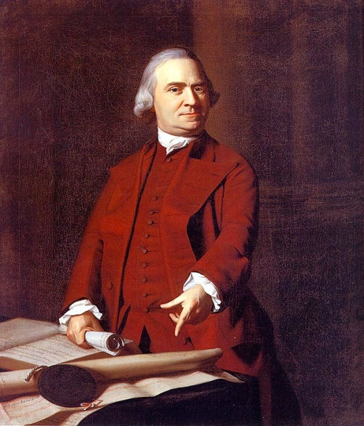
The Revolution Begins
The Shot Heard Round the World
Loyalist spies told General Thomas Gage - the new governor of Massachusetts – that the Massachusetts militia was storing arms and ammunition in Concord, about 20 miles northwest of Boston.
Spies also inform Gage that John Hancock and Sam Adams were in Lexington. Gage decides to move.
Thomas Gage
Samuel Adams

Slide 10
The Revolution Begins
April 18, 1775: The British make their move.
Gage sent 700 soldiers to seize the arms in Concord and arrest Adams and Hancock in Lexington.
Which way would they go?
The Sons of Liberty had built a spy network of their own. They were prepared.
Robert Newman in the Old North Church took the watch.
One light in the steeple if the British advanced across land.
Two lights if they rowed across the Charles River.
Paul Revere and William Dawes saw two lights and set off on horseback to sound the alarm.
Samuel Prescott joined the ride in Lexington. When Revere and Dawes were stopped by the British, Prescott broke away and got to Concord.

Slide 12
The Revolution Begins
Warned by the riders, the alarm was raised. Drums sounded and church bells rang out.

Slide 13
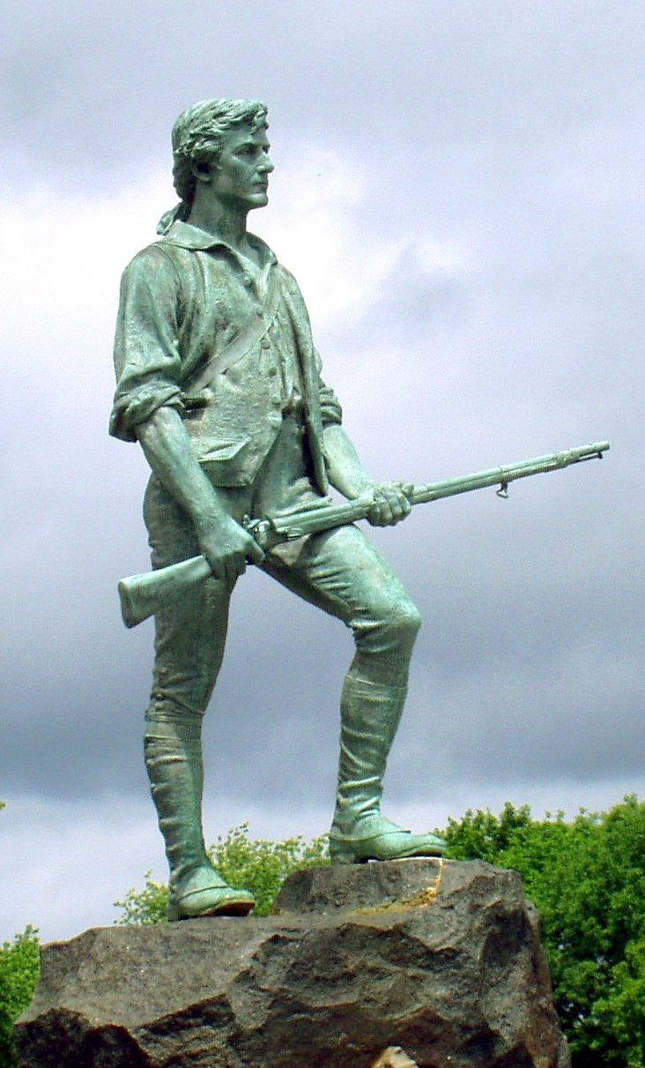

Slide 14
The Revolution Begins
The Battles of Lexington and Concord
The first battles of the American Revolution
The Minutemen learn they can defeat the British
The British learn the minutemen will not fight a conventional war
THE REVOLUTION HAS BEGUN!

Slide 15
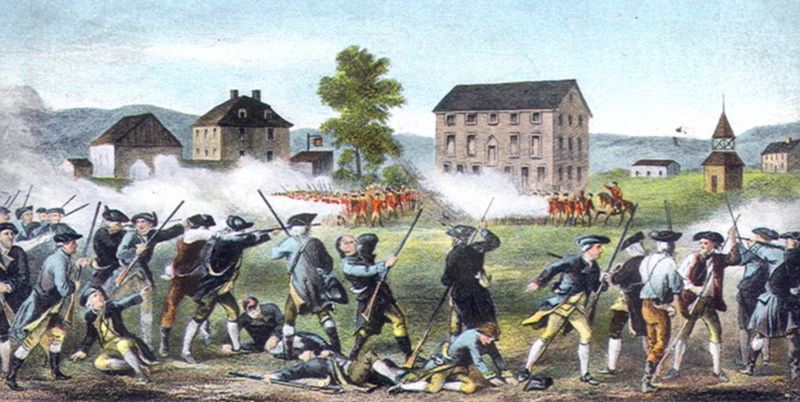
The Revolution Begins
Lexington
At dawn on April 19, 1775, Gage’s 700 “redcoats” arrive at Lexington, about five miles from Concord.
They are met by Patriot captain John Parker and his 70 men.
A shot rang out. No one knows who fired it.
Eight minutemen lay dead; ten were wounded. The battle was over in minutes. The British head towards Concord.

Slide 16
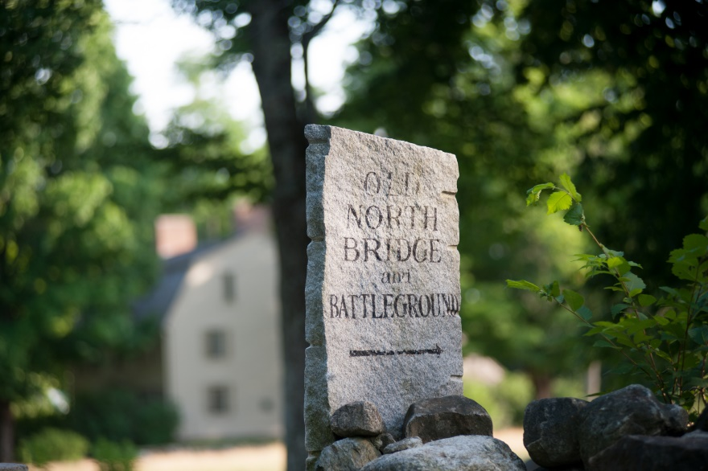
The Revolution Begins
Concord
Warned by Prescott, the citizens of Concord hid the weapons before the British arrived.
The British destroyed what weapons they could find, and burned some buildings
By this time, 400 Minutemen had arrived to fight the British.
A battle broke out at a bridge north of town.
Skilled colonial marksmen find the British “redcoats” easy targets.
The British retreat to Boston.

Slide 18
The Revolution Begins
As April 19 unfolds, nearly 4000 minutemen arrive in the area. They line the roads back to Boston and pepper the retreating British soldiers with musket fire.
“It seemed as if men came down from the clouds,” one British soldier said.
Only the arrival of 1000 more troops saved the British forces from being completely defeated by the patriot militia and minutemen.

Slide 20
The Revolution Begins
After the Battles of Lexington and Concord (Video 2:35)

Slide 21
The Revolution Begins
The First Continental Congress had committed to meeting in the Spring of 1775 to determine whether war would be necessary.
But it seemed war had already begun at Lexington and Concord in April.
The Second Continental Congress meets in May 1775.

Slide 22
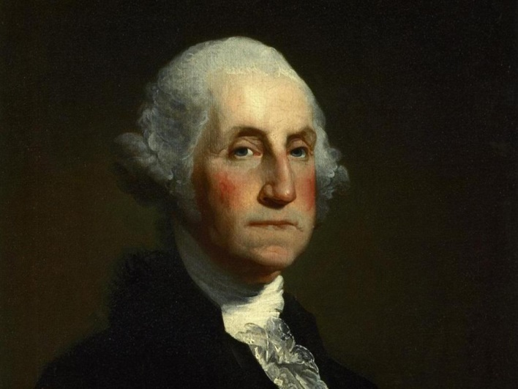
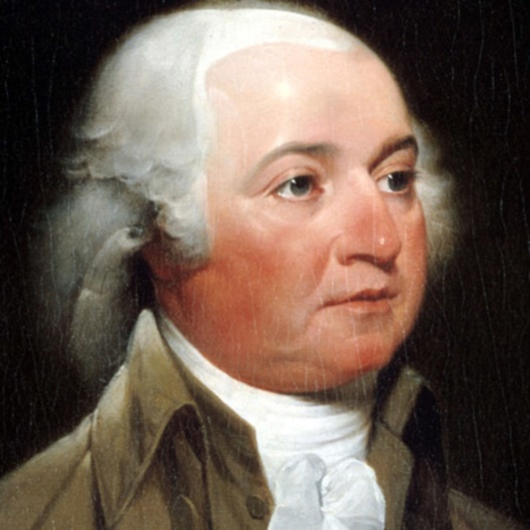
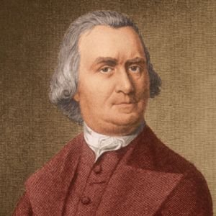
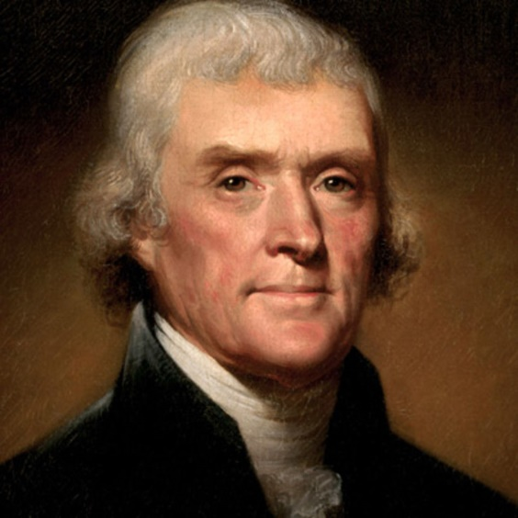
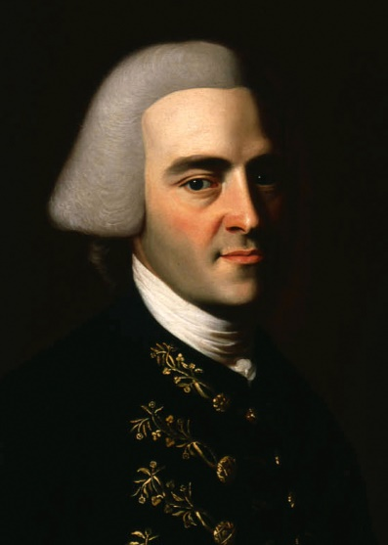
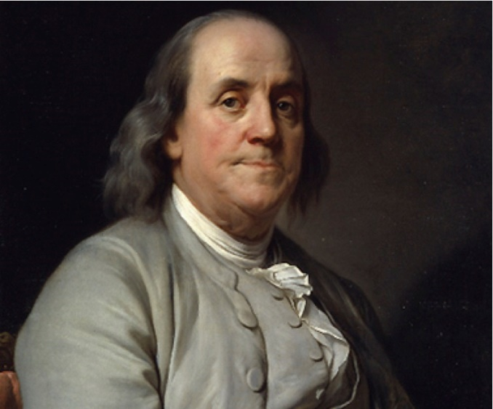
The Revolution Begins
Delegates to the Second Continental Congress include

Slide 23
George Washington
John
Adams
Samuel
Adams
Thomas
Jefferson
John Hancock
Benjamin
Franklin

Slide 24
The Revolution Begins
The Second Continental Congress was divided about what to do.
A group of delegates from New England wanted to declare independence.
A more moderate group from the Middle Colonies favored less drastic action.
All agree, however, they need to prepare for war.

Slide 25
The Revolution Begins
The Second Continental Congress takes action.
Instructed colonial authorities to write state constitutions – a plan for a system of government
Authorized the formation of a Continental Army – the force of soldiers from all colonies that would carry out the fight against Great Britain
Chose George Washington to command the Continental Army
Printed paper money to pay for the Continental Army.
Signed the Olive Branch Petition – a final attempt to restore peace with Great Britain. (King George III refused to read it. He declared the colonies in open rebellion and sent 20,000 more soldiers to the colonies.)

Slide 26
The Revolution Begins
Patriots – colonists who chose to fight for independence from Great Britain
40-45% of the colonists were Patriots.
Loyalists – colonists who chose to side with the British
20-30% of colonists had loyalist sympathies
Included wealthiest merchants and landowners
Feared a rebellion would lead to a change in government and they would lose their wealth and position
Enslaved African-Americans fought with the British, hoping to win their freedom.
Most Native Americans fought with the British, hoping to keep their lands.

Slide 27
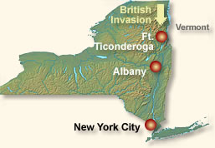
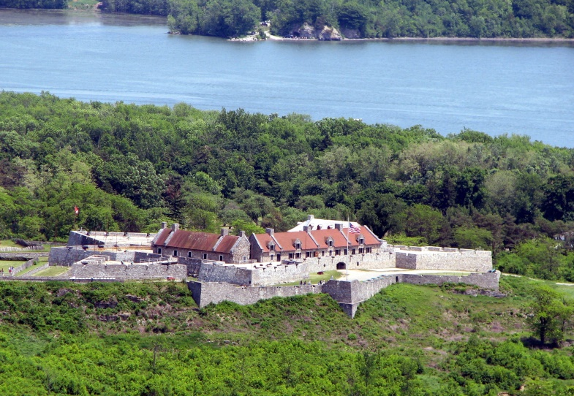
The Revolution Begins
Early Battles
Fort Ticonderoga
Fort Ticonderoga was in an important strategic location.
It overlooked a potential British invasion route from Canada.
If successful, the British would be able to separate new England from the other colonies.

Slide 28
The Revolution Begins
Fort Ticonderoga
May 10, 1775
Ethan Allen with his 83 Green Mountain Boys – from the Green Mountains of Vermont – and Benedict Arnold crossed Lake Champlain at night and surprised the 42 British soldiers guarding the fort.
“I ordered the commander, Captain de la Place, to come forth instantly, or I would sacrifice the whole garrison; at which the Captain came immediately to the door, with his breeches in his hand, when I ordered him to deliver me the fort instantly; he asked me by what authority I demanded it: I answered him, 'In the name of the great Jehovah and the Continental Congress.’ ”
- Ethan Allen

Slide 29
The Revolution Begins
Fort Ticonderoga was important for two reasons:
It controlled the main water route between Canada and the Hudson River Valley.
It held valuable weapons –especially cannons – that the Americans desperately needed.

Slide 30
The Revolution Begins
The Battle of Bunker Hill
After Lexington and Concord, 10,000 colonists left Boston. The city was occupied by 13,500 British troops.
June 17, 1775: The British awake to find they are surrounded by colonial forces. They will have to fight their way out.
2400 British troops advanced against 1600 colonial militia dug in at Breed’s Hill. (see map on p. 115)
Low on gunpowder, the militia commander ordered, “Don’t fire until you see the whites of their eyes!”
The British fall back twice, taking heavy losses.
The colonial militia runs out of ammunition, and the British finally break through.

Slide 31
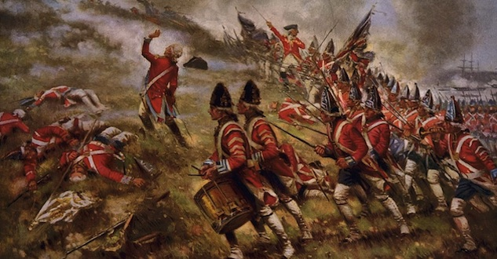
The Revolution Begins
The Battle of Bunker Hill
The British won, but at a terrible cost.
The Americans proved they could stand up to the British army.

Slide 32
The Revolution Begins
John Adams: Beyond Bunker Hill (Video 4:05)

Slide 33
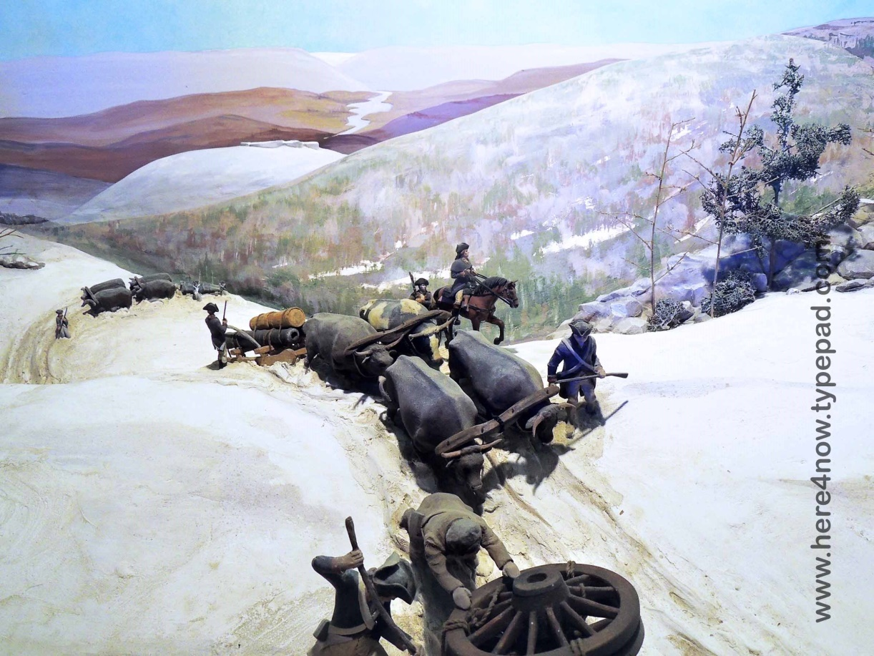
The Revolution Begins
Washington takes command
Washington needs heavier guns to drive the British out of Boston.
Washington assigns Henry Knox to bring the cannons from Ft. Ticonderoga 300 miles over rough terrain in mid-winter.
Washington stations on Nook’s Hill overlooking Boston
When British General Howe sees this, he abandons Boston and retreats to (British) Canada.
Notes:
Heavier guns

Slide 34
The Revolution Begins
John Adams: Henry Knox and Dorchester Heights (3:16)

Slide 35
End Part Two.

