Slide 1
The American Revolution
Part Four:
The Struggle for Liberty

Slide 2
The Struggle for Liberty
Supporting the War Effort
Washington’s primary challenge was finding and keeping soldiers
Congress required each of the states to provide soldiers
Men who had money paid others to serve in their place
Washington questioned whether to recruit African Americans
White southerners opposed the idea
The British offered emancipation to slaves who fought w/ them
In response the Continental Army allowed free blacks to serve
Typical soldier
Young, often under legal fighting age of 16 yrs.
Had little money or property

Slide 3
The Struggle for Liberty
Women also served
Messengers, nurses, spies
Ran farms and businesses back home
Mary Ludwig Hays
Called “Molly Pitcher,” she brought water to men in battle
When her husband was wounded, she took his place loading cannons
Deborah Sampson
Dressed as a man and fought in several battles

Slide 4
The Struggle for Liberty
The British Strategy
Contain the revolution to Massachusetts
Bunker Hill and the cannons from Ticonderoga forced the British to evacuate Boston
So… this strategy failed.
New Strategy:
Capture New York
Many Loyalists there
Use NYC as a base to conquer Middle states
Separate New England from the other states

Slide 5
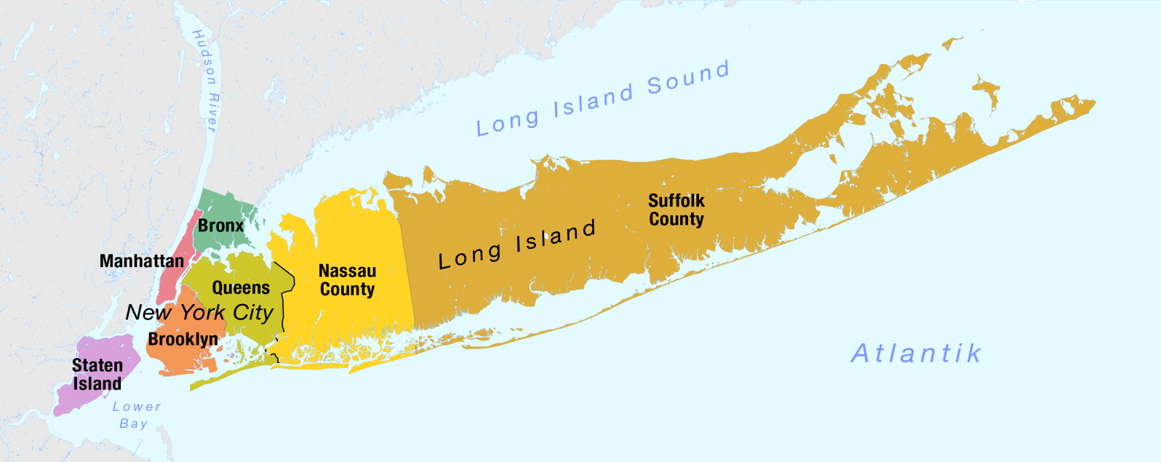
The Struggle for Liberty
Battle of Long Island
June 1776 –
large British fleet arrives off New York
Sir William Howe stations his forces on Staten Island
Washington expected Howe’s arrival. Stations his troops on Brooklyn.

Slide 6
The Struggle for Liberty
Battle of Long Island
British/General Howe
34,000 soldiers and naval force with 10,000 sailors
Ships to ferry soldiers ashore
Well trained and equipped
Americans/General Washington
20,000 soldiers
Poorly trained and equipped
No navy
Summer 1776
Long series of battles and American retreats

Slide 7
The Struggle for Liberty
Battle of Long Island
August 1776
The British drive Washington’s troops out of Brooklyn into New York City (present-day Manhattan)
Washington slips out overnight using fishing boats and bonfires
Video (2:04)
September 1776
The British drive Washington’s troops out of NYC taking thousands of Patriot soldiers and supplies as they go
The Americans are driven west across the Hudson River into New Jersey
Howe’s victory is payback for Boston

Slide 8
The Struggle for Liberty
Video (6:29) The Battle for Long Island Part One
Video (6:07) Battle for Long Island-Washington Slips Away

Slide 9
The Struggle for Liberty
Nathan Hale
Connecticut officer, volunteered for spy duty behind enemy lines
Captured with documents in the soles of his shoes
Sentenced to hang
His last words:
“I regret that I have but one life to lose for my country”

Slide 10
The Struggle for Liberty
Battle of Trenton
Throughout November 1776, Howe continues to push Washington through New Jersey
See map p. 180
Washington has 6000 troops left-his army seems to be vanishing
Terms of service up on December 31
Many deserting
Morale low
December 7, 1776 - Washington retreats across the Delaware River into Pennsylvania

Slide 11
The Struggle for Liberty
Battle of Trenton
Thomas Paine had retreated with the troops. He writes another pamphlet called The Crisis to encourage Americans to support the army and raise morale.
“These are the times that try men’s souls.
The summer soldier and the sunshine patriot will,
in this crisis, shrink from the service of his country;
but he that stands it now deserves the love
and thanks of man and woman.”
Washington had The Crisis read aloud to his troops.

Slide 12
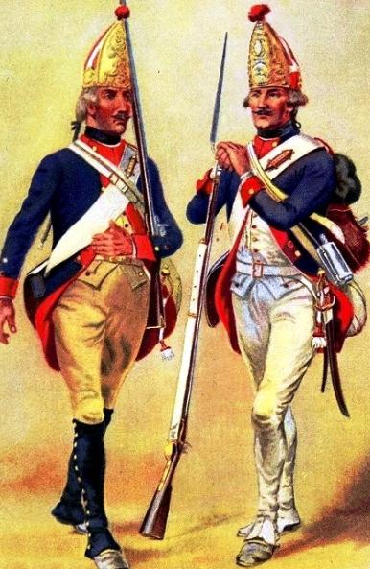
The Struggle for Liberty
Battle of Trenton
Howe believes the Americans are
almost defeated and the rebellion
nearly over.
Howe leaves New Jersey to rest his
troops.
Leaves New Jersey in the hands of
German soldiers from Hesse
Mercenaries: foreign soldiers who
fight for pay

Slide 13
The Struggle for Liberty
Battle of Trenton
Washington decides he needs to risk it and take the offense
Christmas night, December 25 1776, Washington crosses the Delaware back into New Jersey
Winter storm, ice-clogged river, spray freezing on soldiers’ faces
Small boats, silent rowing
Many soldiers have no shoes – feet wrapped in rags – soldiers march through snow to Trenton.
Compare the famous painting by Emanuel Leutze with the reality of the Americans’ experience that Christmas night.

Slide 15
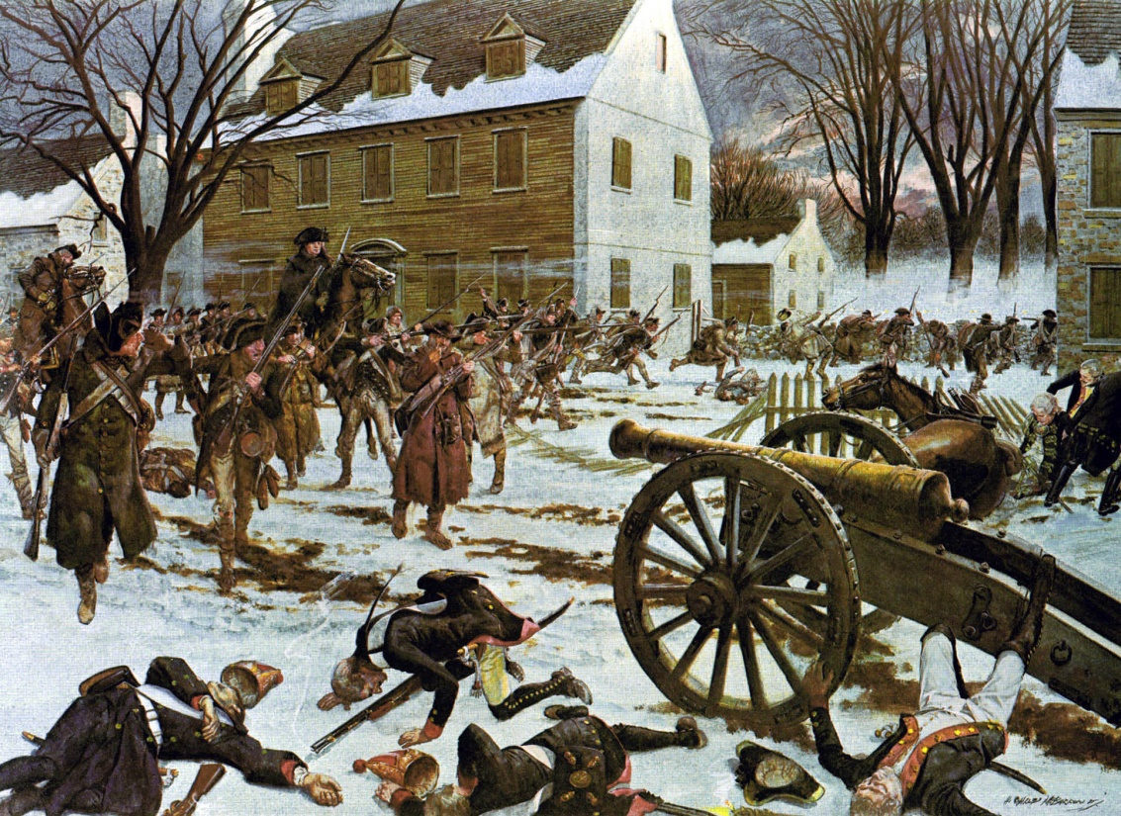
The Struggle for Liberty
Battle of Trenton
December 26, 1776
Hessians asleep at dawn
after their Christmas
celebrations
Patriots attack at Trenton
from two sides –
complete surprise.
Americans take over 900
Hessian prisoners

Slide 16
The Struggle for Liberty
Battle of Princeton
British General Cornwallis rushes his troops north to stop Washington
January 2-3, 1777
Washington leaves campfires burning
Circles behind the British troops in the darkness
Attacked Cornwallis’s troops at daybreak
Americans win
The redcoats flee Princeton
New soldiers arrive to join the Continental Army;
others re-enlist
Washington is back in business
Video (14:59) Washington crosses the Delaware, Battle of Trenton, Battle of Princeton

Slide 17
The Struggle for Liberty
Battle of Saratoga: Turning Point
British Goal: Cut New England off from the rest of the colonies and end the rebellion
British Strategy: a three-pronged attack
From Canada – General Burgoyne would lead 8000 troops to recapture Ft. Ticonderoga and other forts on the upper Hudson River
From the west – drive through the Mohawk River Valley towards Albany
From the south – General Howe would sail up the Hudson to meet at Albany
Perfect Timing is required for this to work

Slide 18
The Struggle for Liberty
King George III orders Howe to go south to capture Philadelphia; Burgoyne does not know this!
The Continental Congress is forced to flee Philadelphia.
Burgoyne moves south from Canada and captures Ticonderoga but is bogged down in thick forests moving south towards Albany.
Minutemen harass British forces along the way.
Cut trees to dam rivers to create obstacles.
American forces block British forces coming from the west.

Slide 19
The Struggle for Liberty
October 1777
American General Horatio Gates meets Burgoyne at Saratoga with 6000 patriot troops.
Benedict Arnold is the hero on the battlefield for the Americans
Burgoyne takes heavy losses - surrenders
The Battle of Saratoga was the turning point of the Revolutionary War.
Video (9:54) The Battle of Saratoga
Video (9:43) The Battle of Saratoga

Slide 20
The Struggle for Liberty
Help from Europe
The American victory at Saratoga convinces Europeans to ally with the US.
Not surprisingly, most of these allies were also enemies of Great Britain.
France
Benjamin Franklin went to France in 1776 to ask for French help. American victories persuaded the French to send money, supplies, soldiers, and ships.
Will widen the war to Caribbean and Europe preventing the British from focusing all their forces in America.
The Netherlands
John Adams traveled to the Netherlands to ask for help. Holland loaned the new American government money to fight the war.

Slide 21
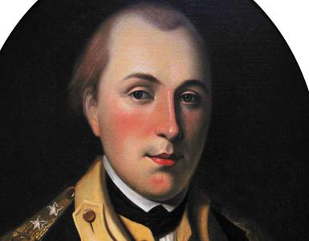
The Struggle for Liberty
Remarkable Volunteers
Marquis deLafayette (French)
Inspired by the ideas behind the revolution
Brought his own ship and soldiers
Gave $200,000 of his own money to support the army
Though he spoke little English, was a skilled commander on the field
Close friends with Washington.
When Lafayette was injured,
Washington said,
“Treat him as my own son.”

Slide 22
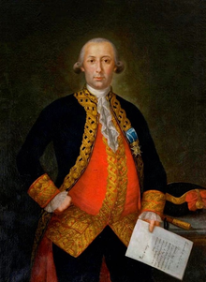
The Struggle for Liberty
Remarkable Volunteers
Marquis deLafayette (French)
Bernardo de Galvez (Spain)
Governor of Spanish Louisiana
Gathered Spanish, French, and Native American troops
Seized British ports along the Gulf coast all
the way to Pensacola, FL

Slide 23
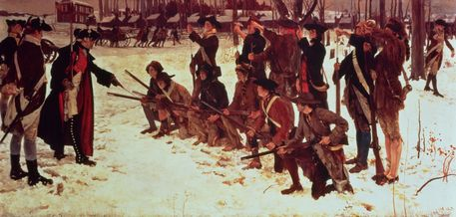
The Struggle for Liberty
Remarkable Volunteers
Marquis deLafayette (French)
Bernardo de Galvez (Spanish)
Baron von Steuben (German)
Helped train the Continental Army
Taught them to march, improve their aim, attack with bayonets

Slide 24
The Struggle for Liberty
Valley Forge
Winter 1777-1778
12,000 American troops dig in at Valley Forge, 22 miles north of Philadelphia
Washington’s men lack food, clothing, supplies
Washington requests supplies from Congress, but Congress arguing over who should pay – states or Congress
2000 soldiers die of disease, cold, starvation
2000 more desert.
Von Steuben continues to train the Americans. Washington wants a well-trained, well-disciplined army by Spring.

Slide 25
The Struggle for Liberty
Video (7:19) The Difficult Winter at Valley Forge
Video (5:50) Valley Forge
The British winter comfortably in Philadelphia
Live in houses abandoned by Patriots
Attend the theater, parties, and balls

Slide 26
The Struggle for Liberty
War at Sea
Congress voted to create an American Navy. The United States Marines and the United States Navy are born.
The United States had eight ships. Britain ruled the seas.
British ships blocked most ships from entering or leaving American ports.
American ships use “hit-and-run” techniques against larger, slower British ships.
American ships attack British supply lines in the West Indies (Caribbean).

Slide 27
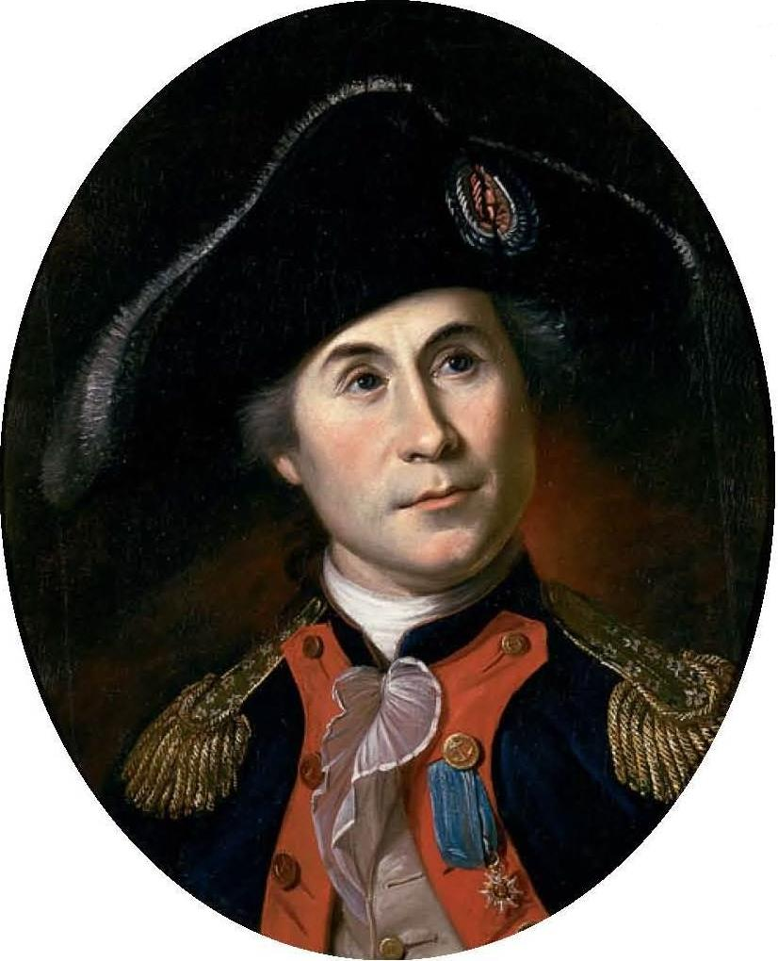
The Struggle for Liberty
War at Sea
John Paul Jones
Captured many British supply ships
The British consider him a pirate.
The French admire his skill –
give him a “fleet” of seven ships.
Captained the Bonhomme Richard
British warship Serapis takes out
Bonhomme Richard’s big guns.
British demand his surrender
“I have not yet begun to fight!”
JPJ accepts the British surrender
hours later.

Slide 28
The Struggle for Liberty
The War in the West
Most Native Americans side with Britain fearing if Americans win, they’ll move west into Native lands
Americans seek to capture British forts and support system in west
George Rogers Clark captures two British trading outposts at Kaskaskia and Cahokia along the Mississippi River in what is now the state of Illinois
They then travel 200 miles, sometimes through icy floodwaters, to take Vincennes.
Clark’s victories allowed settlers to remain on the frontier and strengthen the Americans’ claim on the Ohio River Valley.

Slide 29
Time for a quiz

Slide 30
Independence!
The war in the northern colonies is not going well. Britain turns its eyes south.
New British Commander: General Henry Clinton
British goal:
Capture key southern cities
Win over the local population
March north acquiring states as they go
Strategy:
Enlist Loyalist support in the Carolinas, Georgia Virginia
Free slaves as they go – add fighters

Slide 31
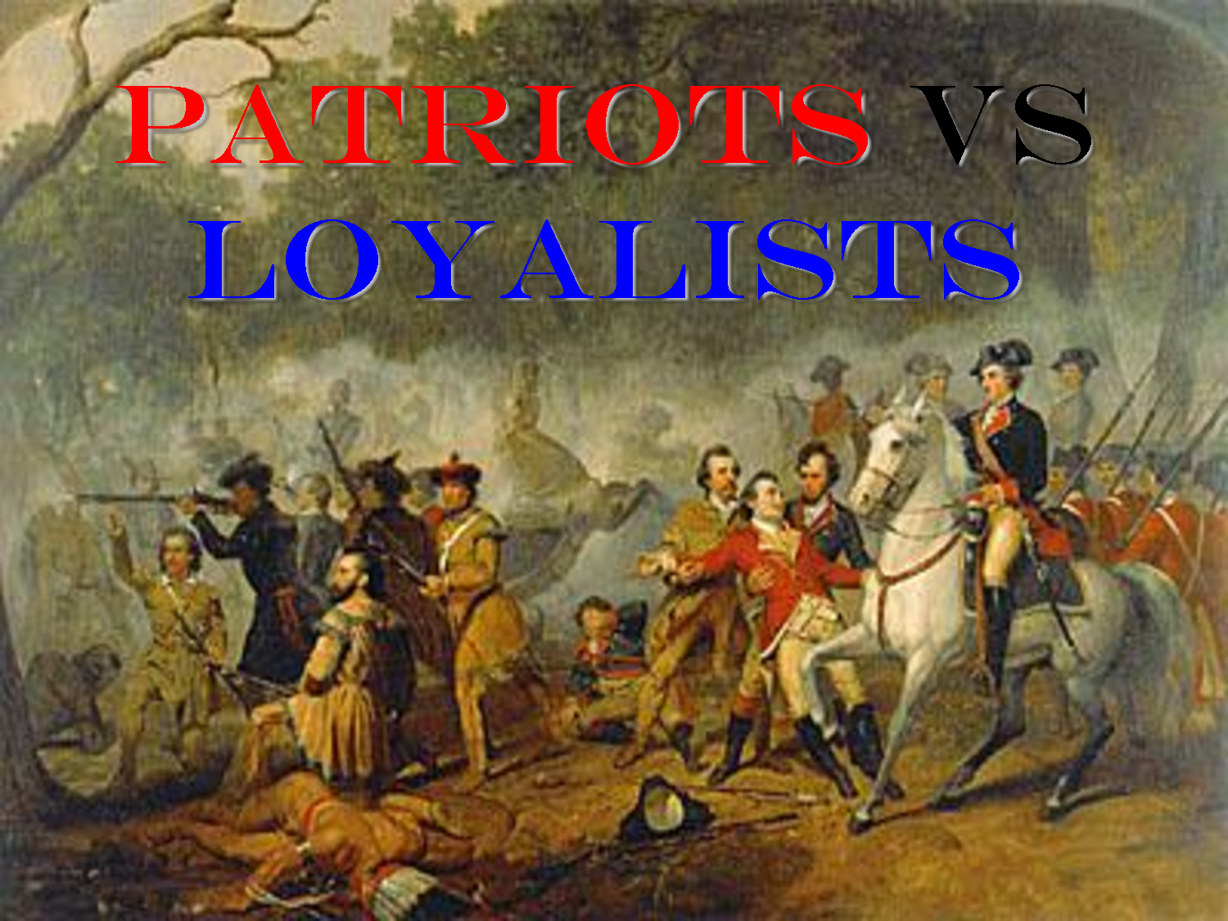
Independence!
Brutal Fighting
American vs. American – Patriots vs. Loyalists
British destroy crops, farm animals, property as they march through the south
Banastre Tarleton – British soldier refused to take prisoners, killed those who surrendered

Slide 32
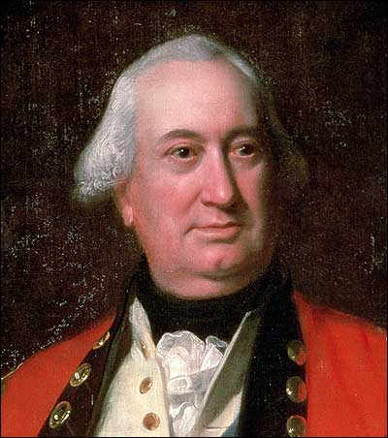
Independence!
British advance
1778 – British take Savannah, GA; soon all of GA
1780 – British take Charles Town, SC;
soon all of SC
British commander Lord Cornwallis
moves the wat to North Carolina

Slide 33
Independence!
Americans fight back
Horatio Gates tries to take back Camden, SC
Americans weak, underfed, in poor health
Attack poorly executed
Only 700 of 4000 American soldiers escape

Slide 34
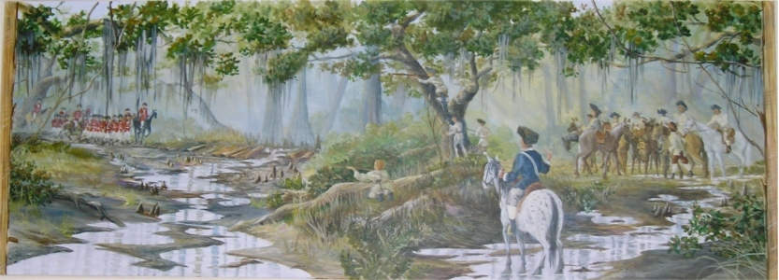
Independence!
Americans use guerilla tactics to slow British advance
Guerillas: fighters who work in small band to make hit-and-run attacks
Francis Marion – aka the “Swamp Fox” successfully led his men on sneak attacks on British throughout South Carolina

Slide 35
Independence!
December 1780 – Nathanael Greene arrives to take over Continental Army in the south
December 1780 – Wins Battle at Kings Mountain in SC
January 1781 – Wins Battle of Cowpens in SC
Cornwallis moves north toward Virginia

Slide 36
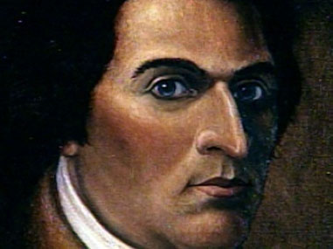
Independence!
Betrayal
Benedict Arnold, hero of Saratoga, plotted to turn over West Point- key fort in NY – over to the British.
Plot was discovered; he escaped
Traitor: a person who betrays his or her country or cause and helps the other side
Now Arnold works with Cornwallis
launching raids on Patriots in VA
with Loyalist soldiers
Why might he betray the cause?
Other officers promoted over him
Felt he didn’t get enough credit
for Saratoga
Wife came from Loyalist family

Slide 37
Independence!
Yorktown – the last major battle of the Revolution
Greene sweeps through the deep south. Only Savannah and Charles Town remain in British hands. Cornwallis moves north to escape him.
Cornwallis makes a fateful mistake: moves to Yorktown peninsula, believing the British fleet will reinforce him off the coast
Washington orders Lafayette to block Cornwallis’s escape by land.
The French naval fleet arrived off Yorktown and chase off British ships
After three weeks, Cornwallis surrenders.
Video – Yorktown: Now or Never (mountvernon.org)

Slide 38
Independence!
Peace with Britain
King George wants to continue fighting; Parliament says no.
Benjamin Franklin and John Adams negotiate terms in Paris.
The Treaty of Paris was signed in 1783
Britain recognizes the independence of the United States
Borders are set
Mississippi River on the west, Florida on the south
Florida returned to Spain.
US agrees to “earnestly recommend” that states return property taken from Loyalists during the war.
Most states ignore this pledge.

Slide 39
Homework Assignment

Slide 40
Chapter Test

